Slide 1



Noida Institute of Engineering and Technology, Greater Noida
MINING ASSOCIATION AND SUPERVISED LEARNING
Unit: 2
MACHINE LEARNING
ACSML0601
Ms. Garima Jain
Assistant Professor
CSBS Department
B Tech 6th Sem
Computer Science and Engineering (Artificial Intelligence)

Slide 2
Evaluation Scheme
Sl. No. | Subject Codes | Subject Name | Periods |  |  | Evaluation Scheme |  |  |  | End Semester |  | Total | Credit
 |  |  | L | T | P | CT | TA | TOTAL | PS | TE | PE
WEEKS COMPULSORY INDUCTION PROGRAM
1 | ACSE0501 | Design and Analysis of Algorithms | 3 | 1 | 0 | 30 | 20 | 50 |  | 100 |  | 150 | 4
2 | ACSE0502 | Computer Networks | 3 | 1 | 0 | 30 | 20 | 50 |  | 100 |  | 150 | 4
3 | ACSE0503 | Design Thinking-II | 2 | 1 | 0 | 30 | 20 | 50 |  | 100 |  | 150 | 3
4 | ACSE0505 | Web Technology | 3 | 0 | 0 | 30 | 20 | 50 |  | 100 |  | 150 | 3
5 |  | Departmental Elective-I | 3 | 0 | 0 | 30 | 20 | 50 |  | 100 |  | 150 | 3
6 |  | Departmental Elective-II | 3 | 0 | 0 | 30 | 20 | 50 |  | 100 |  | 150 | 3
7 | ACSE0551 | Design and Analysis of Algorithms Lab | 0 | 0 | 2 |  |  |  | 25 |  | 25 | 50 | 1
8 | ACSE0552 | Computer Networks Lab | 0 | 0 | 2 |  |  |  | 25 |  | 25 | 50 | 1
9 | ACSE0555 | Web Technology Lab | 0 | 0 | 2 |  |  |  | 25 |  | 25 | 50 | 1
10 | ACSE0559 | Internship Assessment | 0 | 0 | 2 |  |  |  | 50 |  |  | 50 | 1
11 | ANC0501 / ANC0502 | Constitution of India, Law and Engineering / Essence of Indian Traditional Knowledge | 2 | 0 | 0 | 30 | 20 | 50 |  | 50 |  | 100
12 |  | MOOCs (For B.Tech. Hons. Degree)
 |  | GRAND TOTAL |  |  |  |  |  |  |  |  |  | 1100 | 24

Slide 3
Subject Syllabus
B. TECH. THIRD YEAR
Course code | ACSML0601 | L T P | Credits
Course title | MACHINE LEARNING | 3 0 0 | 3
Course objective: To introduction to the fundamental concepts in machine learning and popular machine learning algorithms. To understand the standard and most popular supervised learning algorithm.
Pre-requisites: Basic Knowledge of Machine learning.
Course Contents / Syllabus
UNIT-I | INTRODUCTION TO MACHINE LEARNING |  | 8 Hours
INTRODUCTION – Learning, Types of Learning, Well defined learning problems, Designing a Learning System, History of ML, Introduction of Machine Learning Approaches, Introduction to Model Building, Sensitivity Analysis, Underfitting and Overfitting, Bias and Variance, Concept Learning Task, Find – S Algorithms, Version Space and Candidate Elimination Algorithm, Inductive Bias, Issues in Machine Learning and Data Science Vs Machine Learning.
UNIT-II | MINING ASSOCIATION AND SUPERVISED LEARNING |  | 8 Hours
Classification and Regression, Regression: Linear Regression, Multiple Linear Regression, Logistic Regression, Polynomial Regression, Decision Trees: ID3, C4.5, CART. Apriori Algorithm: Market basket analysis, Association Rules. Neural Networks: Introduction, Perceptron, Multilayer Perceptron, Support vector machine.
UNIT-III | UNSUPERVISED LEARNING |  | 8 Hours
Introduction to clustering, K-means clustering, K-Nearest Neighbor, Iterative distance-based clustering, Dealing with continuous, categorical values in K-Means, Hierarchical: AGNES, DIANA, Partitional: K-means clustering, K-Mode Clustering, density-based clustering, Expectation Maximization, Gaussian Mixture Models.

Slide 4
Subject Syllabus
UNIT-IV | PROBABILISTIC LEARNING & ENSEMBLE | 8 Hours
Bayesian Learning, Bayes Optimal Classifier, Naıve Bayes Classifier, Bayesian Belief Networks. Ensembles methods: Bagging & boosting, C5.0 boosting, Random Forest, Gradient Boosting Machines and XGBoost.
UNIT-V | REINFORCEMENT LEARNING & CASE STUDIES | 8 Hours
Reinforcement Learning: Introduction to Reinforcement Learning, Learning Task, Example of Reinforcement Learning in Practice, Learning Models for Reinforcement – (Markov Decision process, Q Learning – Q Learning function, QLearning Algorithm), Application of Reinforcement Learning. Case Study: Health Care, E Commerce, Smart Cities.

Slide 5
Text Books
Text books:
Marco Gori , Machine Learning: A Constraint-Based Approach, Morgan Kaufmann. 2017
Ethem Alpaydin, Machine Learning: The New AI, MIT Press-2016
Bishop, Christopher. Neural Networks for Pattern Recognition. New York, NY: Oxford University Press, 1995
Tom M. Mitchell, “Machine Learning”, McGraw-Hill, 2010
Reference Books:
Ryszard, S., Michalski, J. G. Carbonell and Tom M. Mitchell, Machine Learning: An Artificial Intelligence Approach, Volume 1, Elsevier. 2014
Stephen Marsland, Taylor & Francis 2009. Machine Learning: An Algorithmic Perspective.
Ethem Alpaydin, (2004) “Introduction to Machine Learning (Adaptive Computation and Machine Learning)”, The MIT Press.
Fundamentals of Machine Learning for Predictive Data Anayltics: Algorithms, Worked Examples, and Case Studies 1st Edition by John D. Kelleher

Slide 6
Branch Wise Applications

Slide 7
Course Objective
To introduce students to the basic concepts of Machine Learning.
To develop skills of implementing machine learning for solving practical problems.
To gain experience of doing independent study and research related to Machine Learning

Slide 8
Course Outcome
At the end of the semester, student will be able to:
Course Outcomes (CO) | CO Description | Blooms’ Taxonomy
CO1 | Understanding utilization and implementation proper machine learning algorithm. | K2
CO2 | Understand the basic supervised machine learning algorithms. | K2
CO3 | Understand the difference between supervise and unsupervised learning. | K2
CO4 | Understand algorithmic topics of machine learning and mathematically deep enough to introduce the required theory. | K2
CO5 | Apply an appreciation for what is involved in learning from data. | K3

Slide 9
Program Outcome
1. Engineering knowledge:
2. Problem analysis:
3. Design/development of solutions:
4. Conduct investigations of complex problems:
5. Modern tool usage:
6. The engineer and society:
7. Environment and sustainability:
8. Ethics:
9. Individual and team work:
10. Communication:
11. Project management and finance:
12. Life-long learning

Slide 10
CO-PO and PSO Mapping
Correlation Matrix of CO with PO
CO.K | PO1 | PO2 | PO3 | PO4 | PO5 | PO6 | PO7 | PO8 | PO9 | PO10 | PO11 | PO12
ACSML0601.1 | 3 | 2 | 2 | 1 | 2 | 2 | - | - | - | 1 | - | -
ACSML0601.2 | 3 | 2 | 2 | 3 | 2 | 2 | 1 | - | 2 | 1 | 1 | 2
ACSML0601.3 | 2 | 2 | 2 | 2 | 2 | 2 | 2 | 1 | 1 | - | 1 | 3
ACSML0601.4 | 3 | 3 | 1 | 3 | 1 | 1 | 2 | - | 2 | 1 | 1 | 2
ACSML0601.5 | 3 | 2 | 1 | 2 | 1 | 2 | 1 | 1 | 2 | 1 | 1 | 1
AVG | 2.8 | 2.2 | 1.6 | 2.2 | 1.6 | 1.8 | 1.2 | 0.4 | 1.4 | 0.8 | 0.8 | 1.6

Slide 11
Program Specific Outcomes
PSO1-Apply Artificial Intelligence and its applications to design intelligent systems for the betterment of society.
PSO2-Develop AI-based innovative solutions demonstrating research, entrepreneurship, professional ethics, and communication skills.
PSO3-Demonstrate competency in AI by working in a team and engaging in life-long learning.

Slide 12
CO-PO and PSO Mapping
Matrix of CO/PSO:
 | PSO1 | PSO2 | PSO3
ACSML0601.1 | 3 | 2 | 3
ACSML0601.2 | 3 | 2 | 2
ACSML0601.3 | 3 | 2 | 3
ACSML0601.4 | 2 | 1 | 1
ACSML0601.5 | 2 | 2 | 1
AVG | 2.6 | 1.8 | 2

Slide 13
Program Educational Objectives
PEO1-Engage in successful professional practices in the area of Artificial Intelligence and pursue higher education and research.
PEO2-Demonstrate effective leadership and communicate as an individual and as a team in the workspace and society.
PEO3-Pursue life-long learning in developing AI-based innovative solutions for the betterment of society.

Slide 14
Result Analysis
ML Result of 2020-21: 89.39%
Average Marks: 46.05

Slide 15
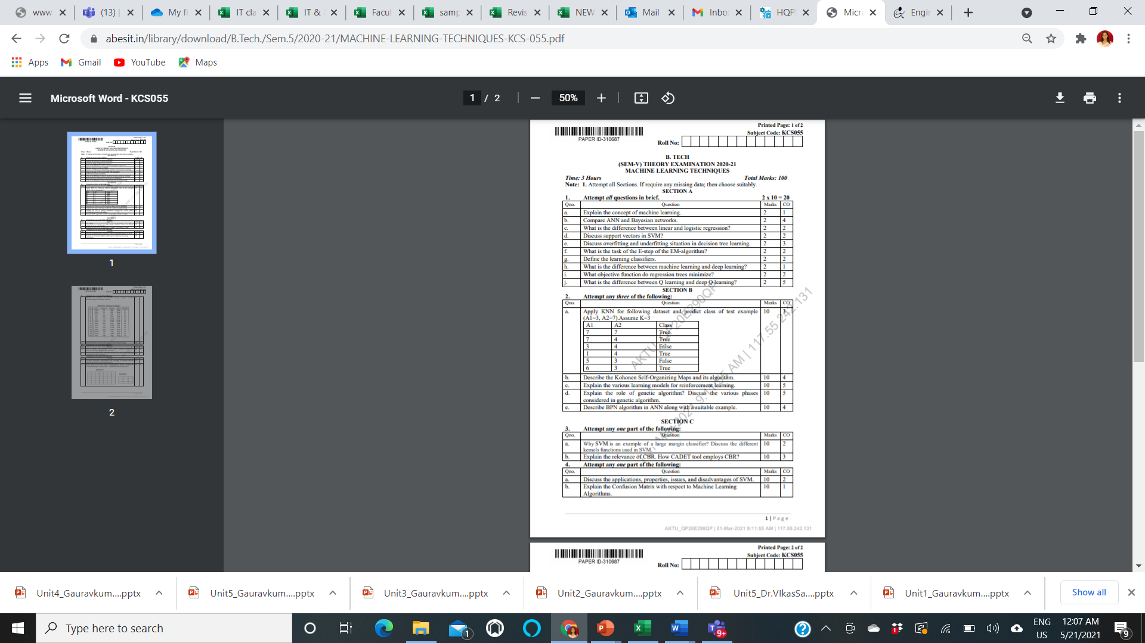
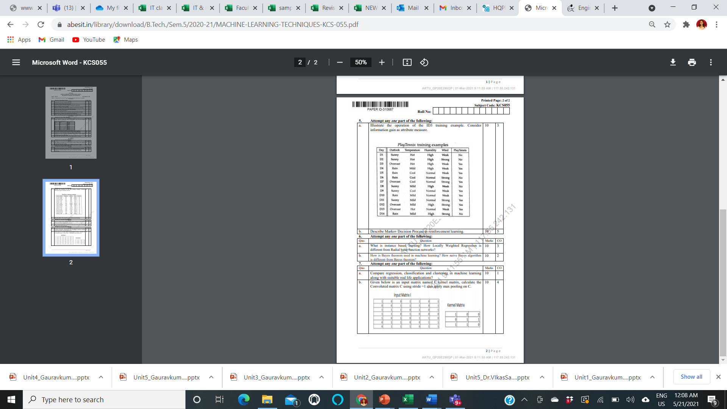
End Semester Question Paper Template

Slide 16
Prerequisite
Prerequisites:
Statistics.
Linear Algebra.
Calculus.
Probability.
Programming Languages.

Slide 17
Brief Introduction to Subject
https://www.youtube.com/watch?v=PPLop4L2eGk&list=PLLssT5z_DsK-h9vYZkQkYNWcItqhlRJLN

Slide 18
Topic Mapping with Course Outcome
Topics | Course outcome
Classification and Regression, Regression Decision Trees: ID3, C4.5, CART. Apriori Algorithm: Market basket analysis, Association Rules. | CO2 CO2 CO2

Slide 19
Lecture Plan

Slide 20
Lecture Plan

Slide 21
Lecture Plan

Slide 22
Lecture Plan

Slide 23
Lecture Plan

Slide 24
Unit 2 Content:
Classification and Regression,
Regression: Linear Regression,
Multiple Linear Regression,
Logistic Regression,
Polynomial Regression,
Decision Trees: ID3, C4.5, CART.
Apriori Algorithm: Market basket analysis, Association Rules.
Neural Networks: Introduction, Perceptron, Multilayer Perceptron, Support vector machine.

Slide 25

Unit Objective
The objective of the Unit 2
1. To understand the basics of Regression,
2. To understand the concept of Decision Tree Algorithm
3. To understand the brief working of Artificial Neural Network

Slide 26
Topic Objective
Student will be able to understand
Regression
Linear Regression
Logistic Regression
Polynomial Regression

Slide 27
Regression (CO2)
Linear Regression vs Logistic Regression
Linear Regression and Logistic Regression are the two famous Machine Learning Algorithms which come under supervised learning technique.
Since both the algorithms are of supervised in nature hence these algorithms use labeled dataset to make the predictions.
But the main difference between them is how they are being used.
The Linear Regression is used for solving Regression problems whereas Logistic Regression is used for solving the Classification problems.

Slide 28
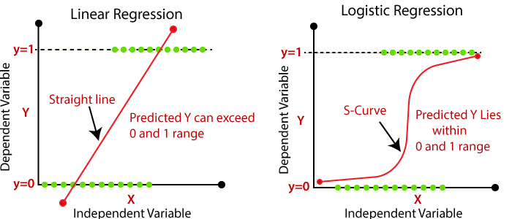
Regression (CO2)

Slide 29
Regression (CO2)
Linear Regression:
Linear Regression is one of the most simple Machine learning algorithm that comes under Supervised Learning technique and used for solving regression problems.
It is used for predicting the continuous dependent variable with the help of independent variables.
The goal of the Linear regression is to find the best fit line that can accurately predict the output for the continuous dependent variable.
If single independent variable is used for prediction then it is called Simple Linear Regression and if there are more than two independent variables then such regression is called as Multiple Linear Regression.
By finding the best fit line, algorithm establish the relationship between dependent variable and independent variable. And the relationship should be of linear nature.
The output for Linear regression should only be the continuous values such as price, age, salary, etc. The relationship between the dependent variable and independent variable can be shown in below image:

Slide 30
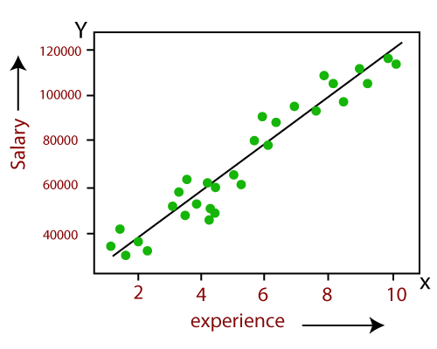
Regression (CO2)

Slide 31
Introduction (CO2)
Logistic Regression:
Logistic regression is one of the most popular Machine learning algorithm that comes under Supervised Learning techniques.
It can be used for Classification as well as for Regression problems, but mainly used for Classification problems.
Logistic regression is used to predict the categorical dependent variable with the help of independent variables.
The output of Logistic Regression problem can be only between the 0 and 1.
Logistic regression can be used where the probabilities between two classes is required. Such as whether it will rain today or not, either 0 or 1, true or false etc.
Logistic regression is based on the concept of Maximum Likelihood estimation. According to this estimation, the observed data should be most probable.
In logistic regression, we pass the weighted sum of inputs through an activation function that can map values in between 0 and 1. Such activation function is known as sigmoid function and the curve obtained is called as sigmoid curve or S-curve. Consider the below image:

Slide 32

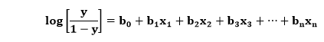
Regression (CO1)
The equation for logistic regression is:

Slide 33

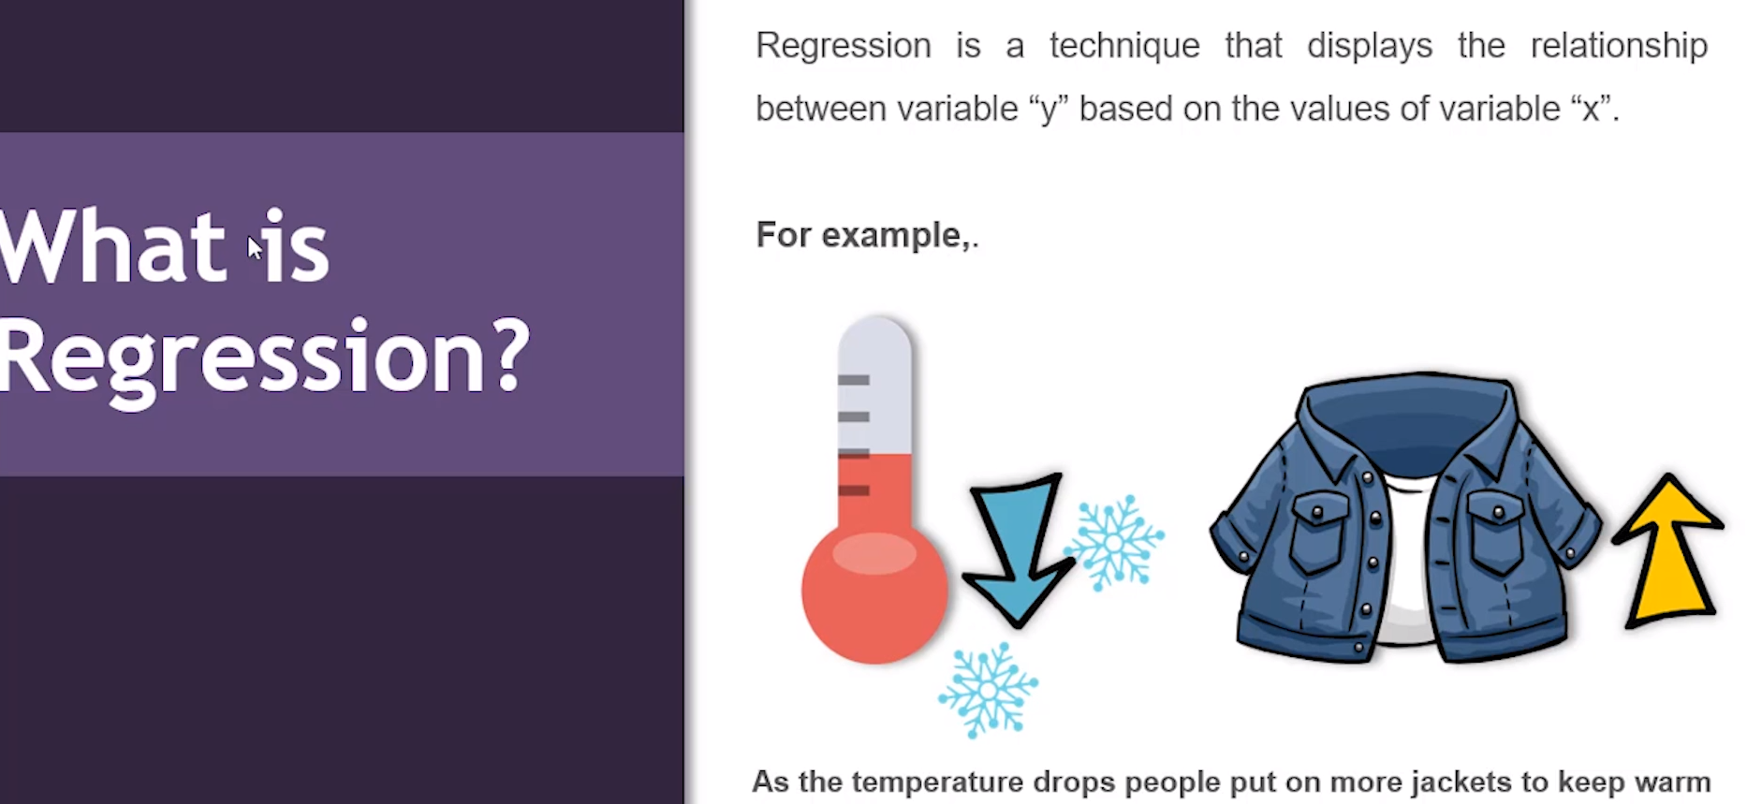

What is Regression?
Regression Analysis is a predictive modelling technique
It estimates the relationship between a dependent (target) and an independent variable(predictor)

Slide 34
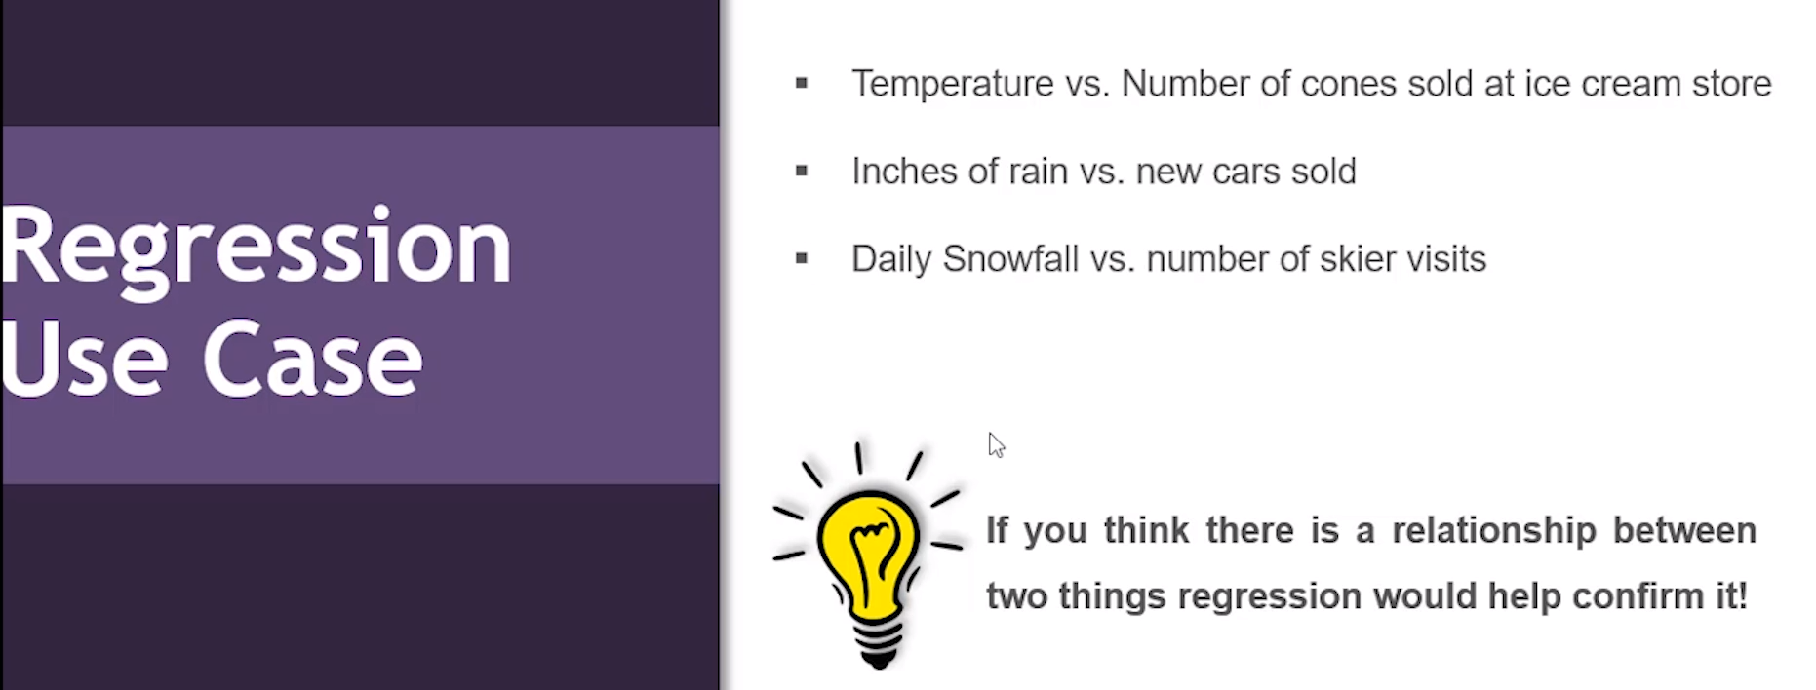
Use Case: Regression?

Slide 35
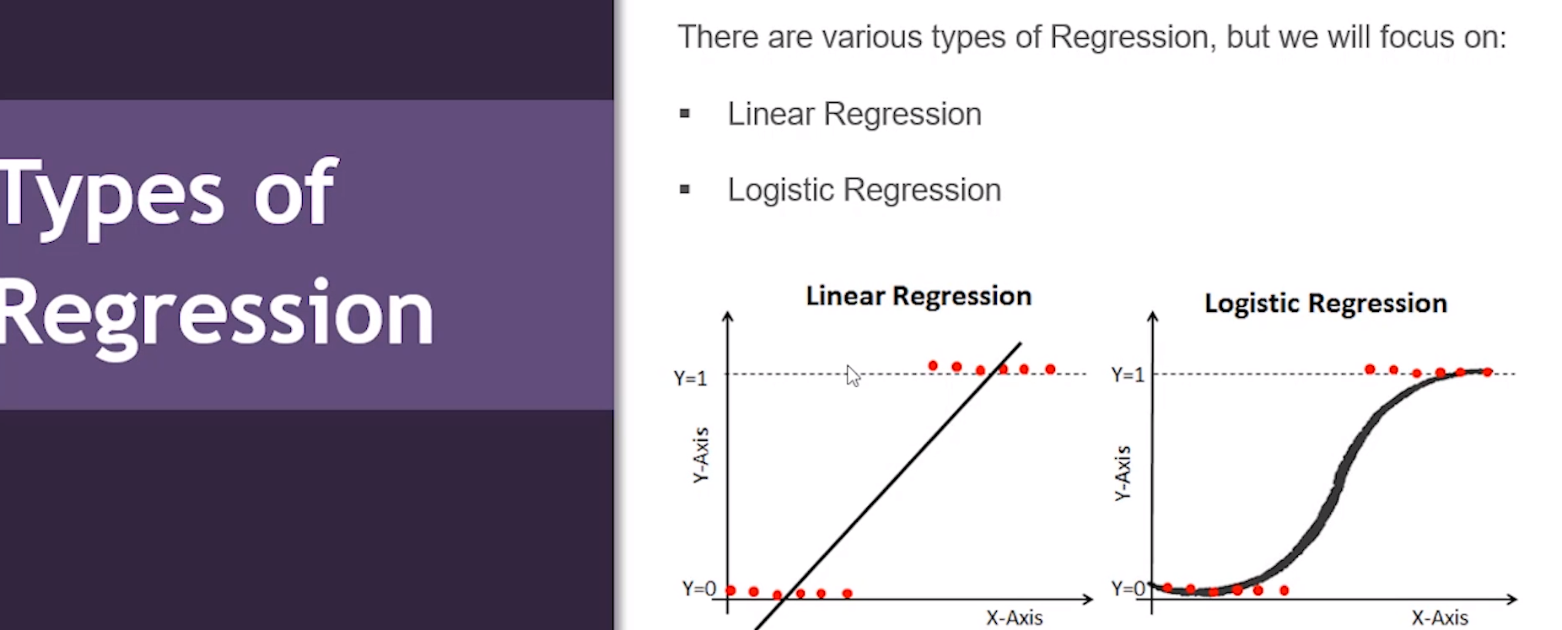
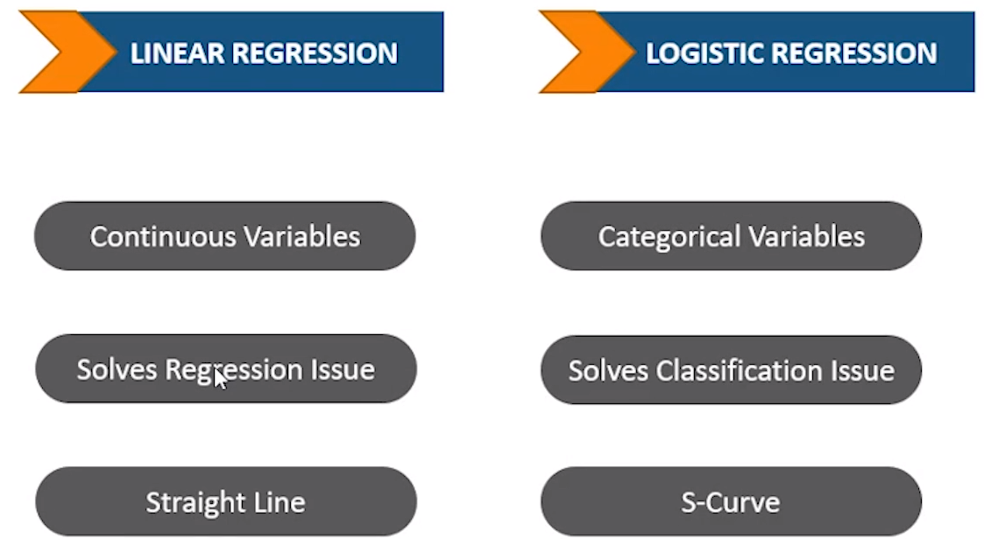
Use Case: Regression?

Slide 36

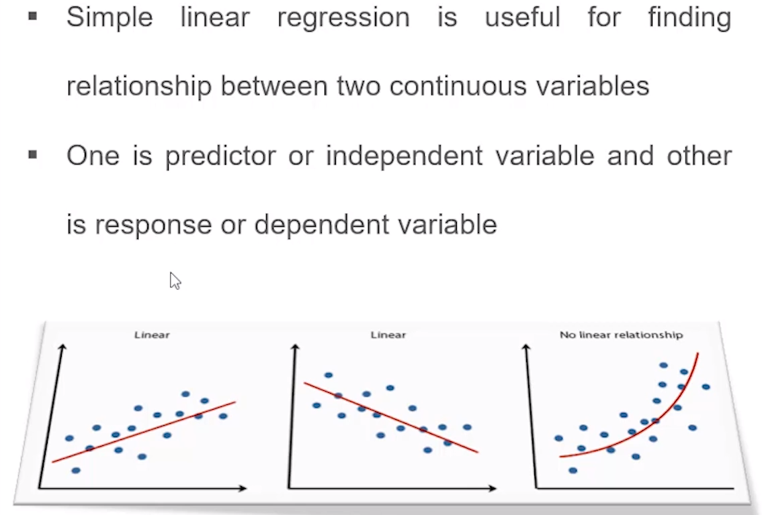
Regression!!

Slide 37
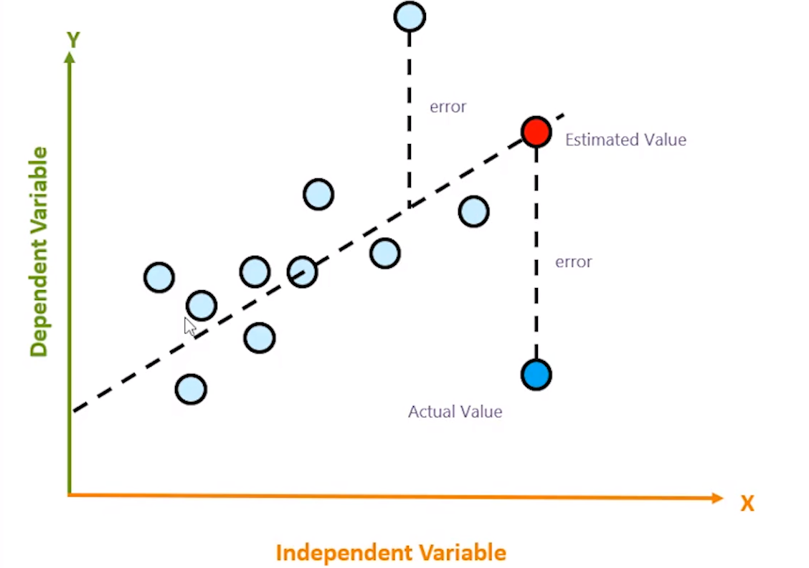
Regression!!

Slide 38
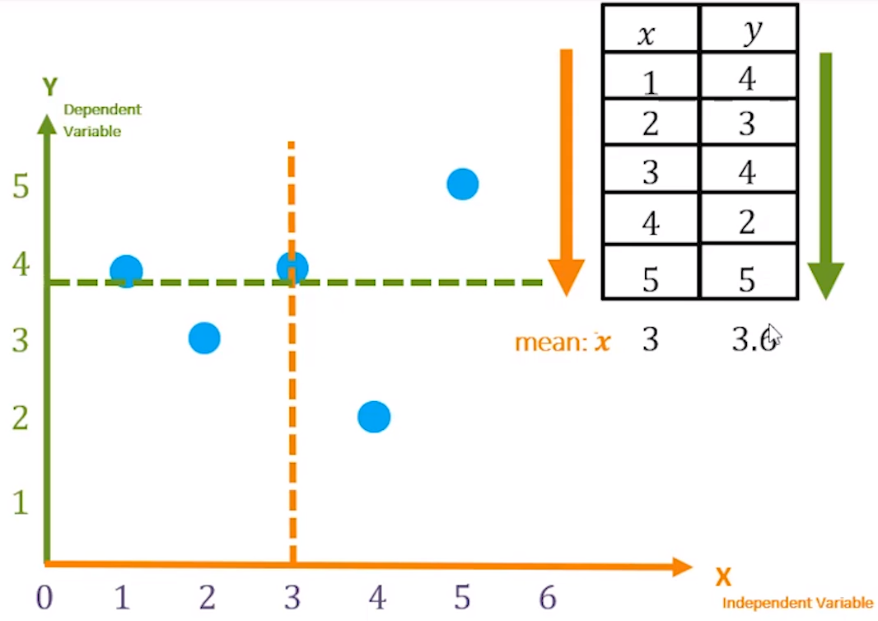
Regression!!

Slide 39
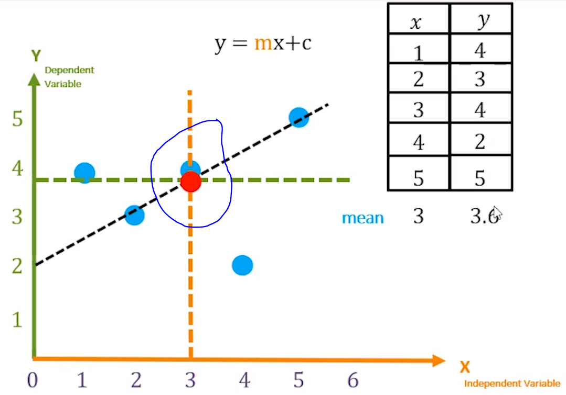
Regression!!

Slide 40
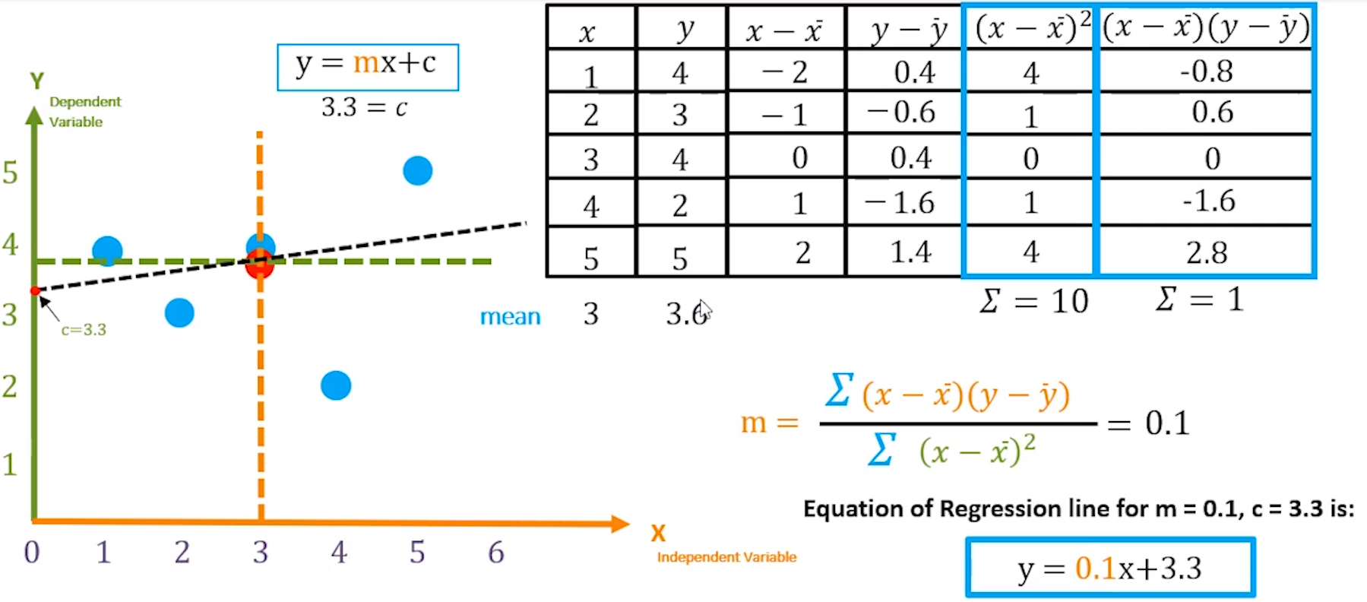
Regression!!

Slide 41
Regression!!

Slide 42
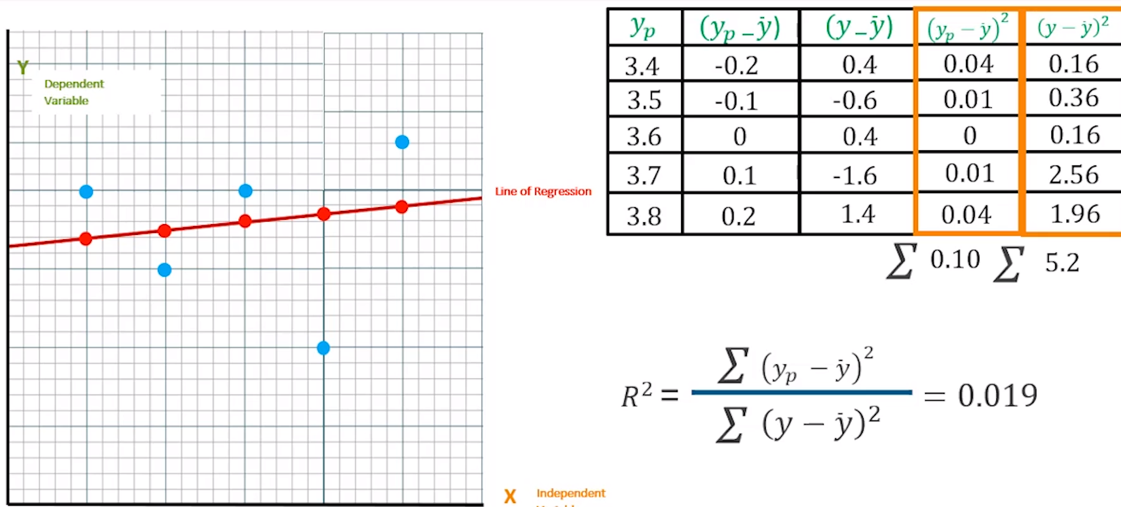
Regression!!

Slide 43
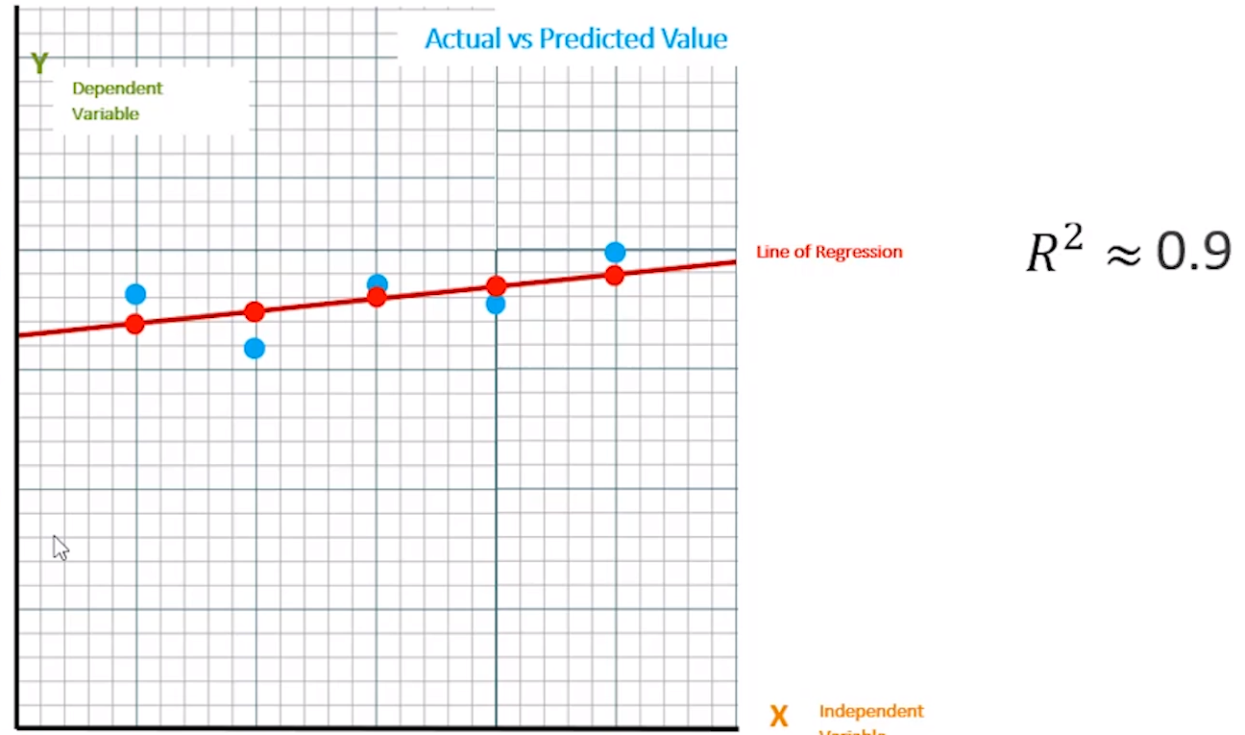
Regression!!

Slide 44
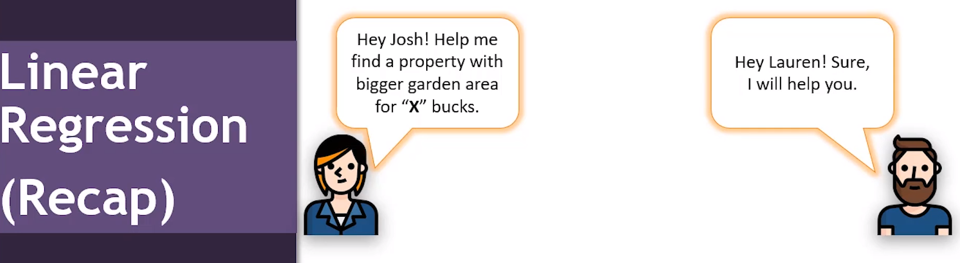
Regression!!

Slide 45
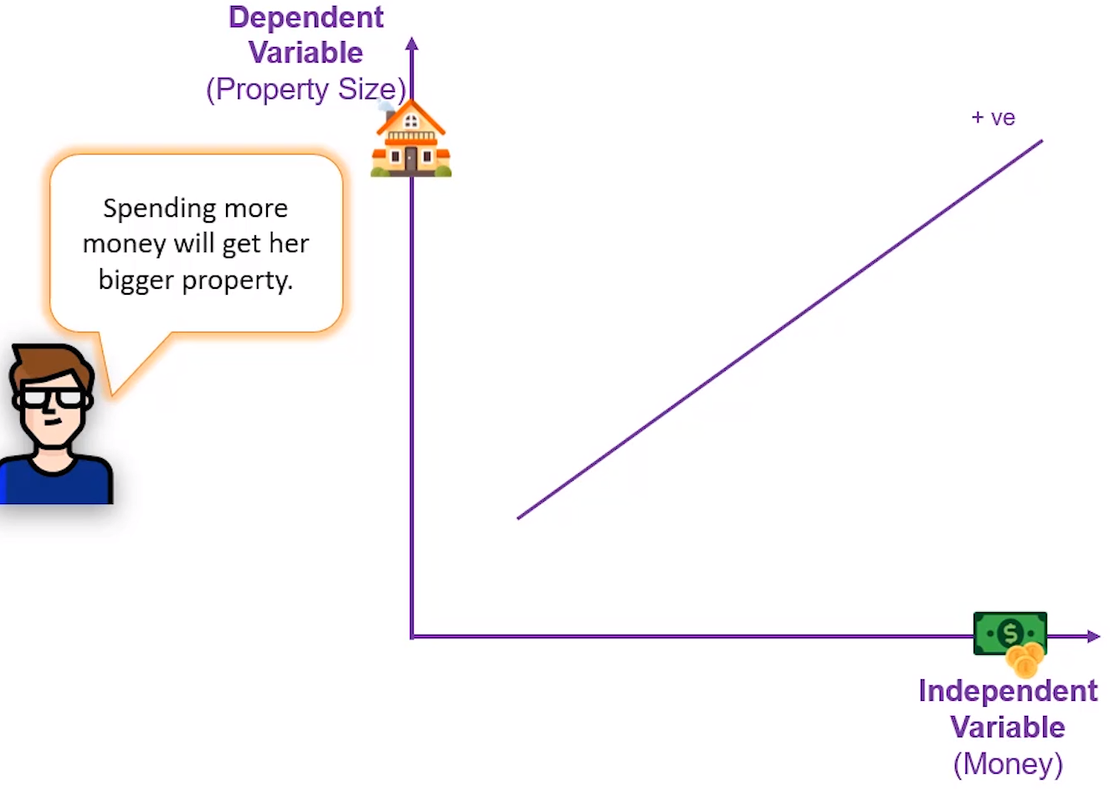
Regression!!

Slide 46
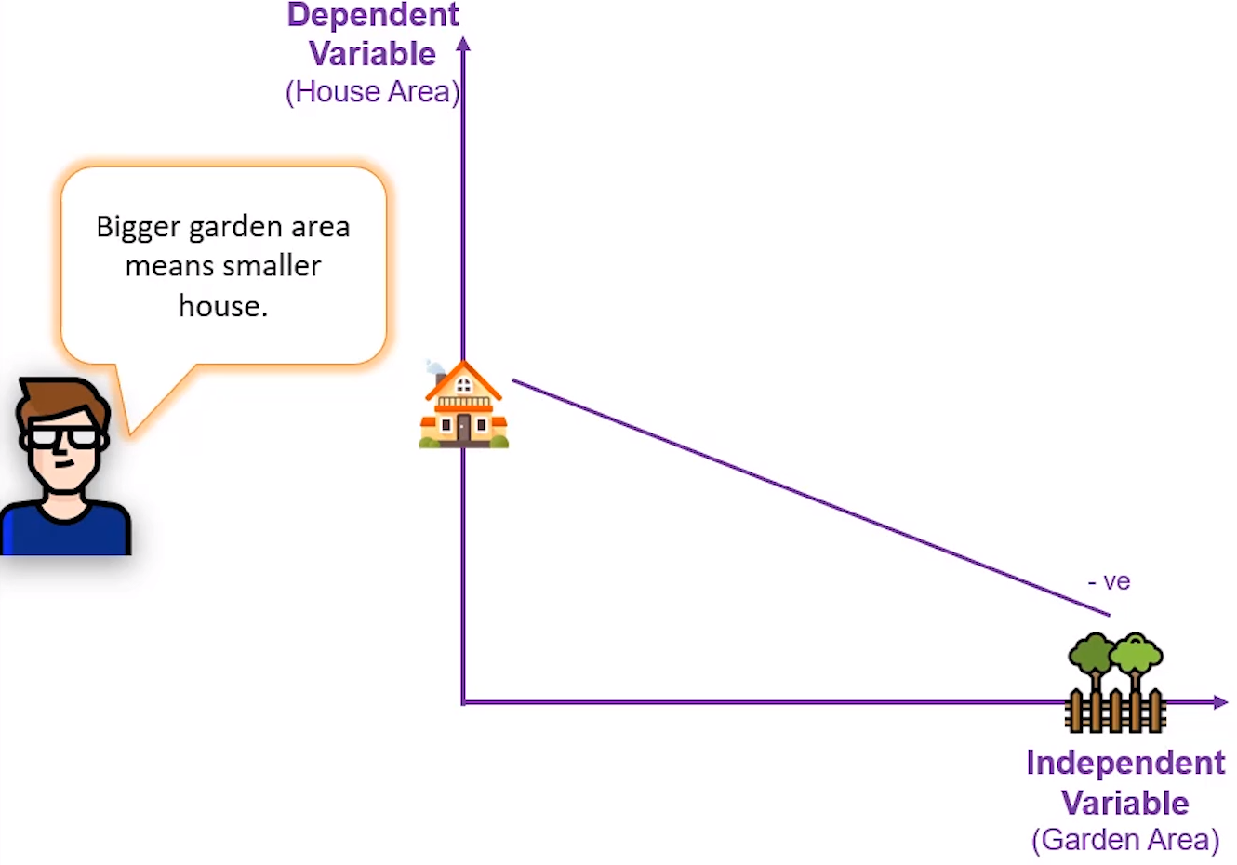
Regression!!

Slide 47
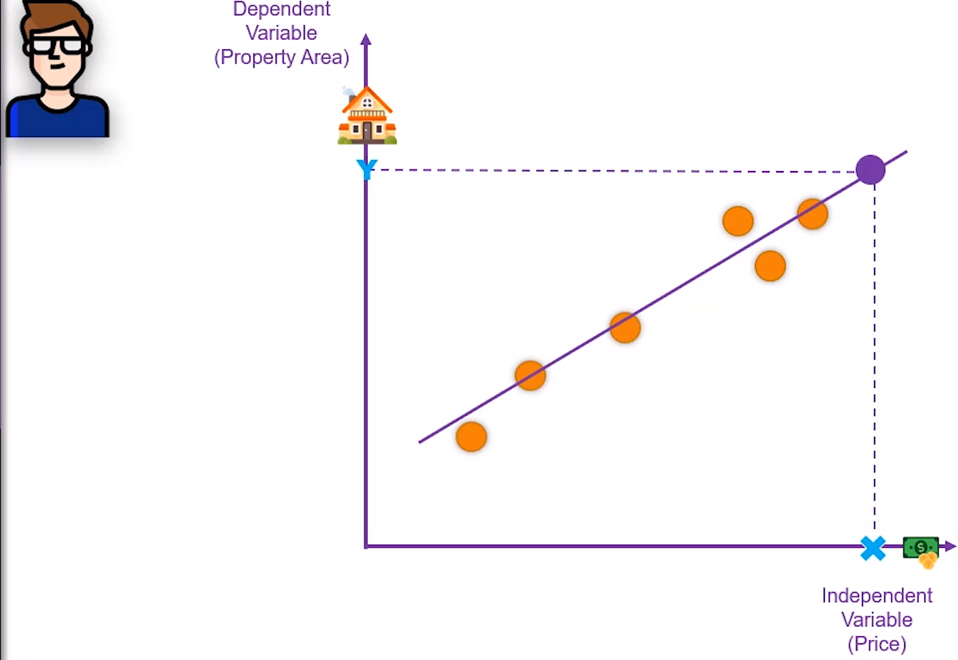
Regression!!

Slide 48
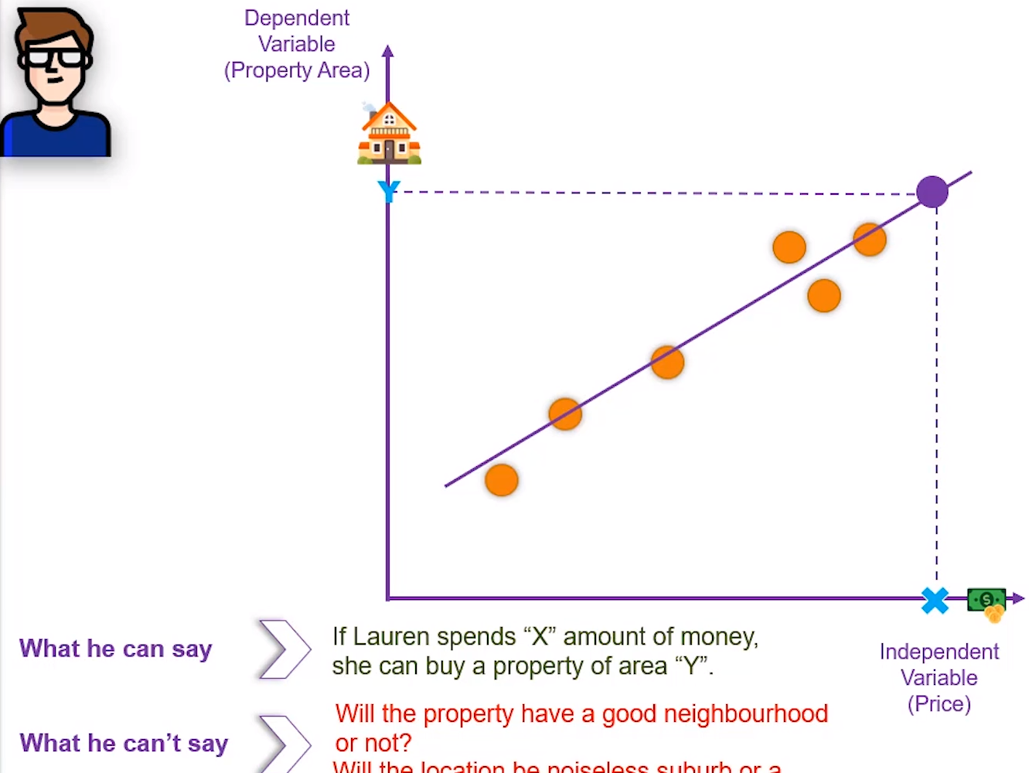
Regression!!

Slide 49
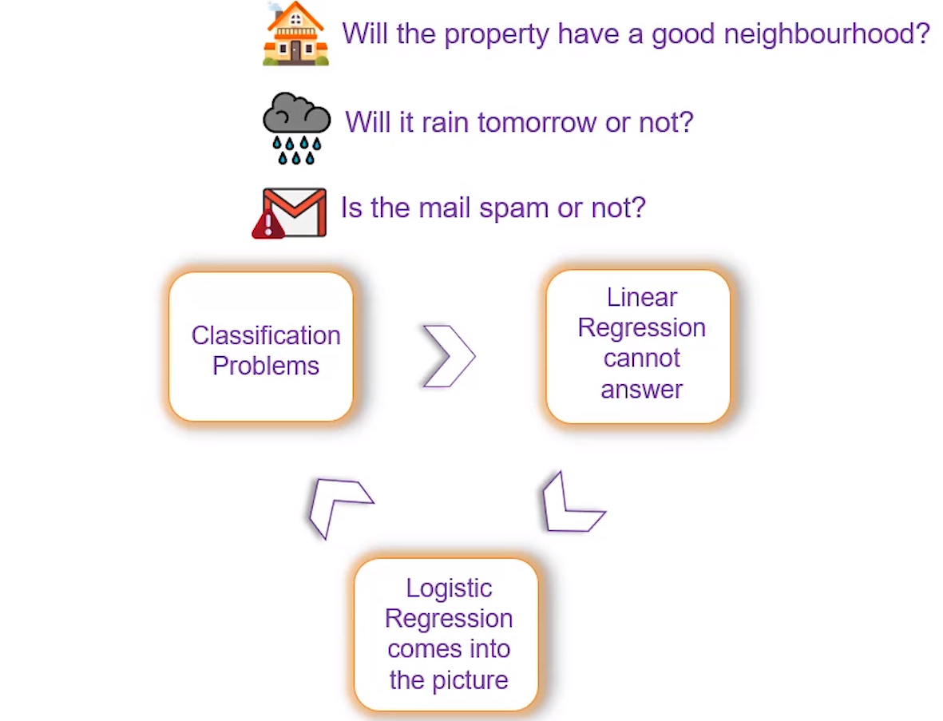
Logistic Regression!!

Slide 50
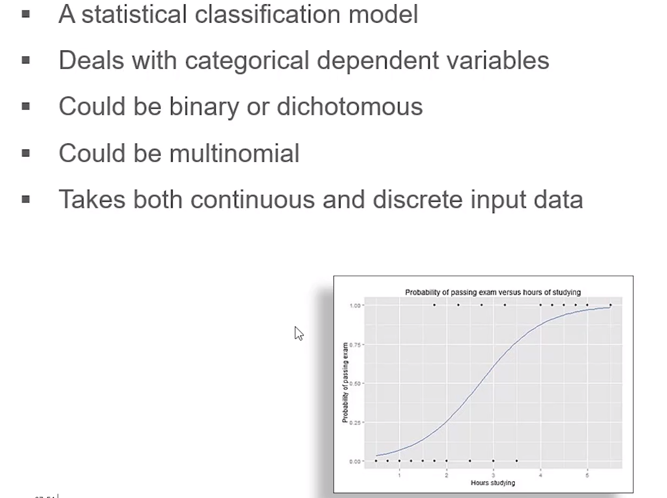
Logistic Regression!!

Slide 51
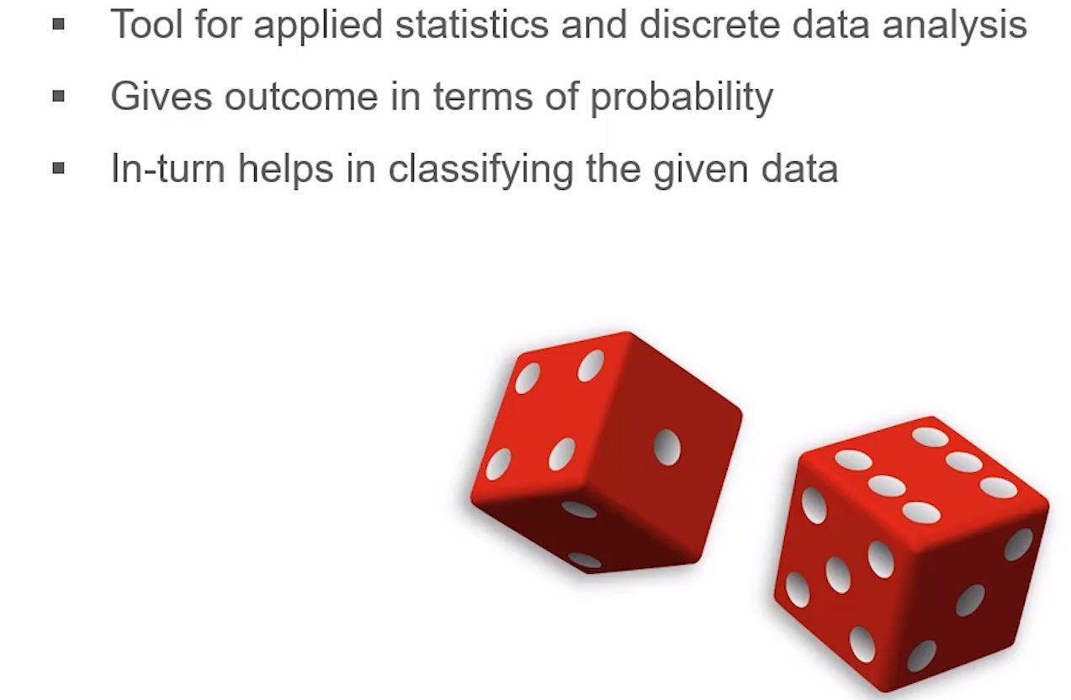
Logistic Regression!!

Slide 52
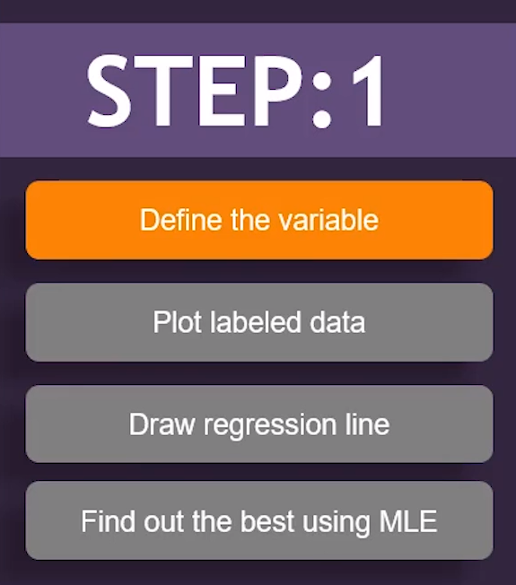
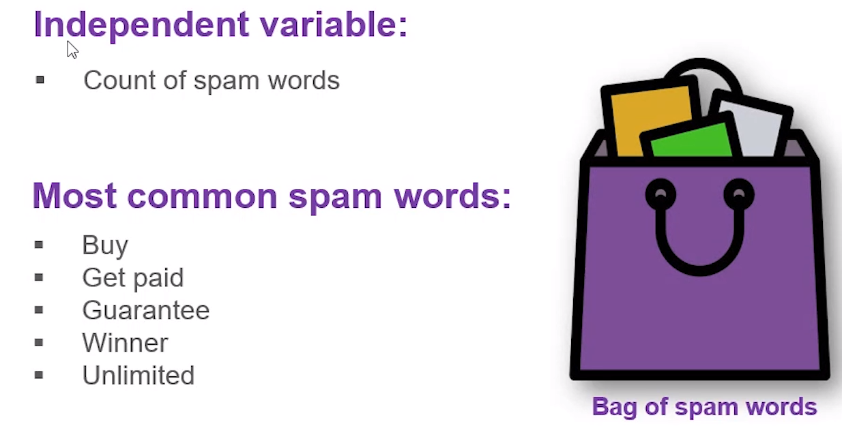
Logistic Regression!!

Slide 53
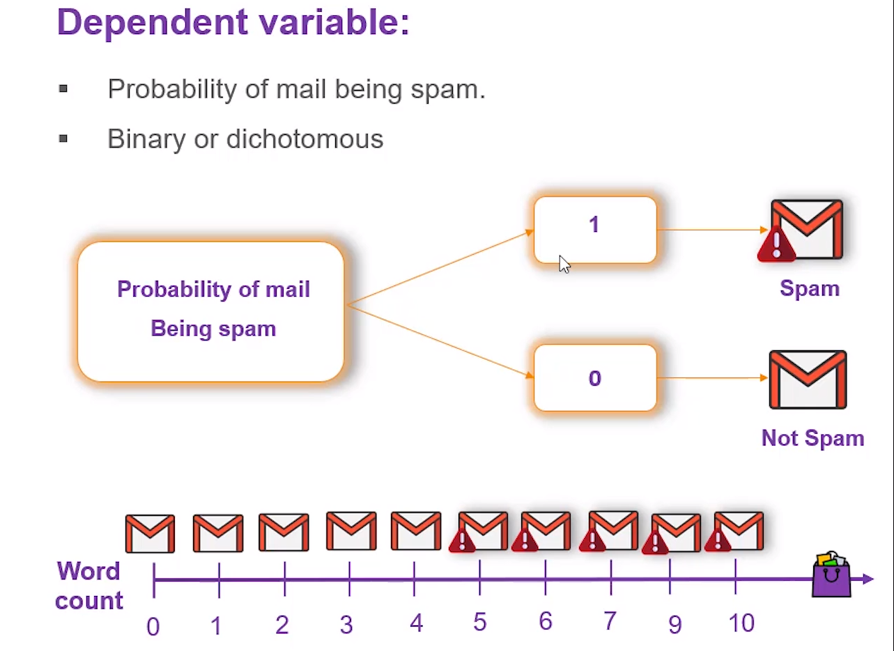
Logistic Regression!!

Slide 54
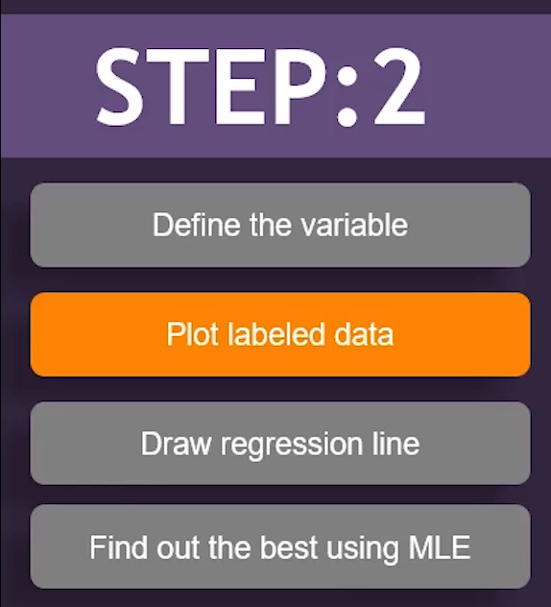
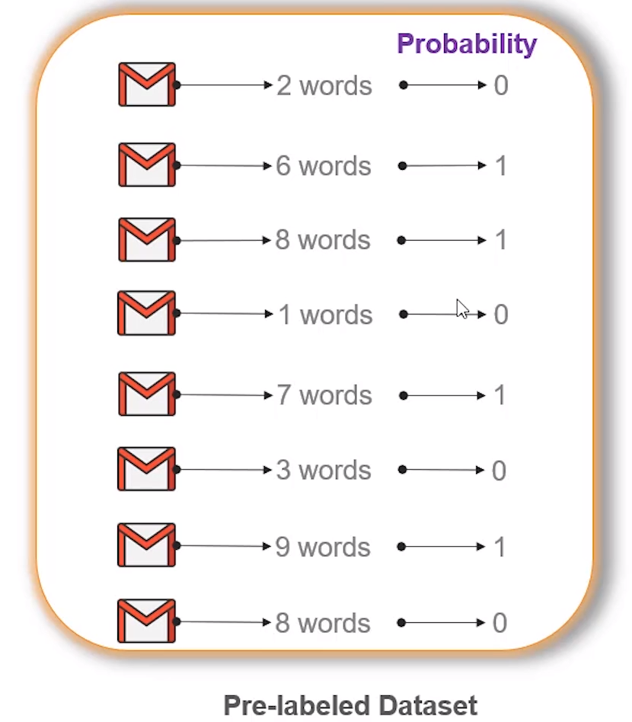
Logistic Regression!!

Slide 55
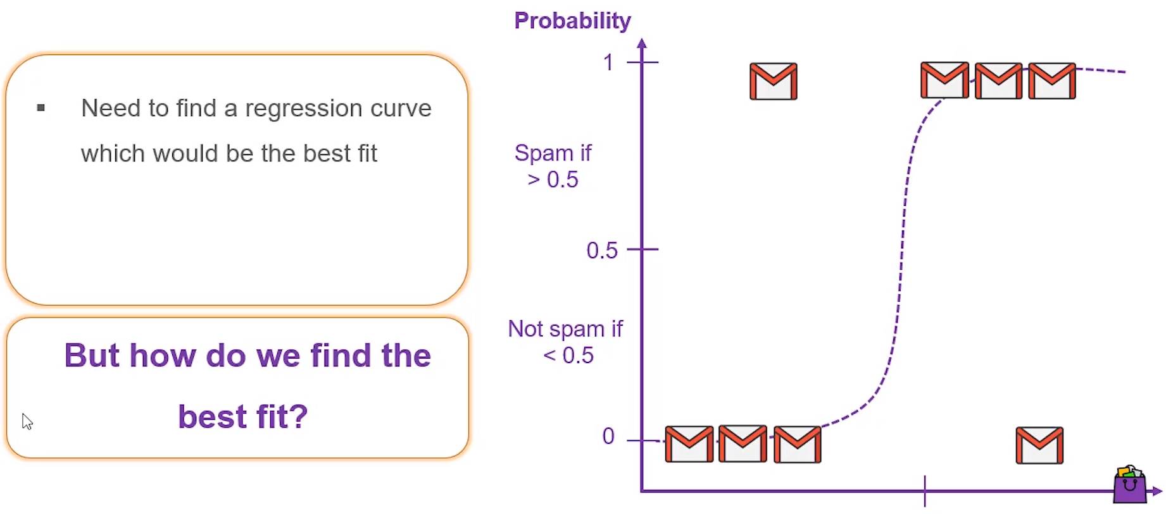
Logistic Regression!!

Slide 56
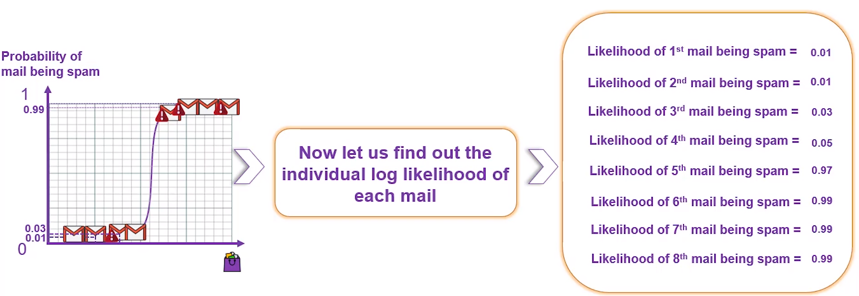
Logistic Regression!!

Slide 57
Logistic Regression!! (CO1)
Probability of passing an exam versus hours of study
To answer the following question:
A group of 20 students spends between 0 and 6 hours studying for an exam. How does the number of hours spent studying affect the probability of the student passing the exam?

Slide 58
Logistic Regression!! (CO1)
Hours | Pass
0.5 | 0
0.75 | 0
1 | 0
1.25 | 0
1.5 | 0
1.75 | 0
1.75 | 1
2 | 0
2.25 | 1
2.5 | 0
2.75 | 1
3 | 0
3.25 | 1
3.5 | 0
4 | 1
4.25 | 1
4.5 | 1
4.75 | 1
5 | 1
5.5 | 1
 | Coefficient | Std.Error | z-value | P-value (Wald)
Intercept | −4.0777 | 1.761 | −2.316 | 0.0206
Hours | 1.5046 | 0.6287 | 2.393 | 0.0167

Slide 59
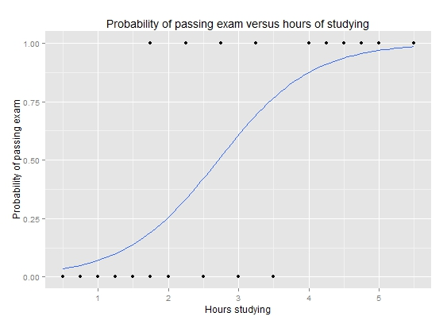
Logistic Regression!! (CO1)

Slide 60
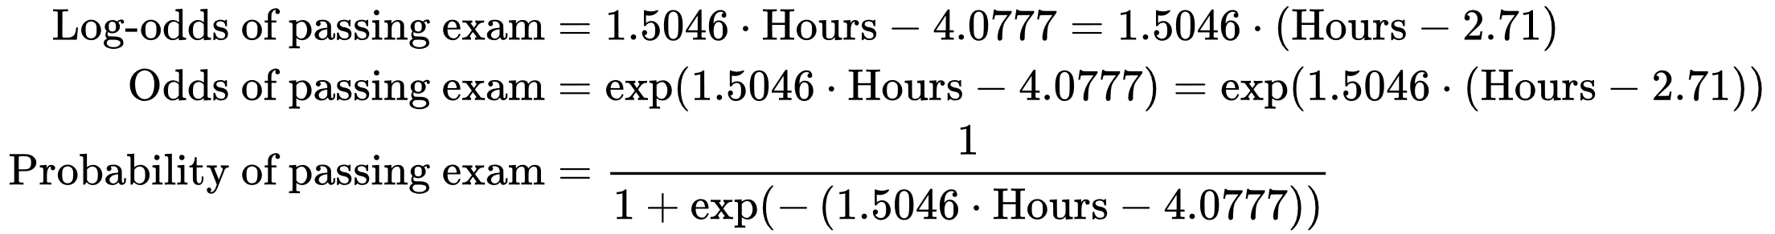
Logistic Regression!! (CO1)

Slide 61
Logistic Regression!! (CO1)
Linear Regression | Logistic Regression
Linear regression is used to predict the continuous dependent variable using a given set of independent variables. | Logistic Regression is used to predict the categorical dependent variable using a given set of independent variables.
Linear Regression is used for solving Regression problem. | Logistic regression is used for solving Classification problems.
In Linear regression, we predict the value of continuous variables. | In logistic Regression, we predict the values of categorical variables.
In linear regression, we find the best fit line, by which we can easily predict the output. | In Logistic Regression, we find the S-curve by which we can classify the samples.
Least square estimation method is used for estimation of accuracy. | Maximum likelihood estimation method is used for estimation of accuracy.
The output for Linear Regression must be a continuous value, such as price, age, etc. | The output of Logistic Regression must be a Categorical value such as 0 or 1, Yes or No, etc.
In Linear regression, it is required that relationship between dependent variable and independent variable must be linear. | In Logistic regression, it is not required to have the linear relationship between the dependent and independent variable.
In linear regression, there may be collinearity between the independent variables. | In logistic regression, there should not be collinearity between the independent variable.

Slide 62
Decision Tree (CO1,2,3,5)
Introduction
Classification is a two-step process, learning step and prediction step, in machine learning.
In the learning step, the model is developed based on given training data.
In the prediction step, the model is used to predict the response for given data.
Decision Tree is one of the easiest and popular classification algorithms to understand and interpret.

Slide 63
Decision Tree (CO1,2,3,5)
Decision Tree Algorithm
Decision Tree algorithm belongs to the family of supervised learning algorithms.
Unlike other supervised learning algorithms, the decision tree algorithm can be used for solving regression and classification problems too.
The goal of using a Decision Tree is to create a training model that can use to predict the class or value of the target variable by learning simple decision rules inferred from prior data(training data).
In Decision Trees, for predicting a class label for a record we start from the root of the tree.
We compare the values of the root attribute with the record’s attribute.
On the basis of comparison, we follow the branch corresponding to that value and jump to the next node.

Slide 64
Decision Tree (CO1,2,3,5)
Types of Decision Trees
Types of decision trees are based on the type of target variable we have. It can be of two types:
Categorical Variable Decision Tree: Decision Tree which has a categorical target variable then it called a Categorical variable decision tree.
Continuous Variable Decision Tree: Decision Tree has a continuous target variable then it is called Continuous Variable Decision Tree.

Slide 65
Decision Tree (CO1,2,3,5)
Important Terminology related to Decision Trees:
Root Node: It represents the entire population or sample and this further gets divided into two or more homogeneous sets.
Splitting: It is a process of dividing a node into two or more sub-nodes.
Decision Node: When a sub-node splits into further sub-nodes, then it is called the decision node.
Leaf / Terminal Node: Nodes do not split is called Leaf or Terminal node.
Pruning: When we remove sub-nodes of a decision node, this process is called pruning. You can say the opposite process of splitting.
Branch / Sub-Tree: A subsection of the entire tree is called branch or sub-tree.
Parent and Child Node: A node, which is divided into sub-nodes is called a parent node of sub-nodes whereas sub-nodes are the child of a parent node.

Slide 66
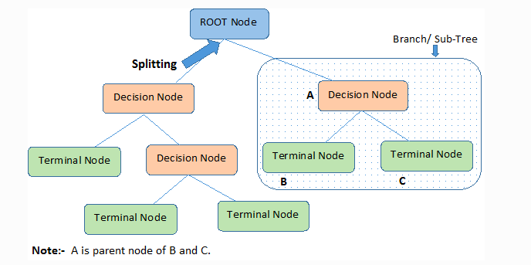
Decision Tree (CO1,2,3,5)

Slide 67
Decision Tree (CO1,2,3,5)
Decision trees classify the examples by sorting them down the tree from the root to some leaf/terminal node, with the leaf/terminal node providing the classification of the example.
Each node in the tree acts as a test case for some attribute, and each edge descending from the node corresponds to the possible answers to the test case.
This process is recursive in nature and is repeated for every subtree rooted at the new node.

Slide 68
Decision Tree (CO1,2,3,5)
Assumptions while creating Decision Tree:
In the beginning, the whole training set is considered as the root.
Feature values are preferred to be categorical.
If the values are continuous then they are discretized prior to building the model.
Records are distributed recursively on the basis of attribute values.
Order to placing attributes as root or internal node of the tree is done by using some statistical approach.

Slide 69
Decision Tree (CO1,2,3,5)
How do Decision Trees work?
The decision of making strategic splits heavily affects a tree’s accuracy.
The decision criteria are different for classification and regression trees.
Decision trees use multiple algorithms to decide to split a node into two or more sub-nodes.
The creation of sub-nodes increases the homogeneity of resultant sub-nodes.
In other words, we can say that the purity of the node increases with respect to the target variable.
The decision tree splits the nodes on all available variables and then selects the split which results in most homogeneous sub-nodes.

Slide 70
Decision Tree (CO1,2,3,5)
The algorithm selection is also based on the type of target variables. Let us look at some algorithms used in Decision Trees:
ID3 → (extension of D3) C4.5 → (successor of ID3) CART → (Classification And Regression Tree) CHAID → (Chi-square automatic interaction detection Performs multi-level splits when computing classification trees) MARS → (multivariate adaptive regression splines)

Slide 71
Decision Tree (CO1,2,3,5)
The ID3 (Iterative Dichotomiser 3) algorithm builds decision trees using a top-down greedy search approach through the space of possible branches with no backtracking. A greedy algorithm, as the name suggests, always makes the choice that seems to be the best at that moment.
Steps in ID3 algorithm:
It begins with the original set S as the root node.
On each iteration of the algorithm, it iterates through the very unused attribute of the set S and calculates Entropy(H) and Information gain(IG) of this attribute.
It then selects the attribute which has the smallest Entropy or Largest Information gain.
The set S is then split by the selected attribute to produce a subset of the data.
The algorithm continues to recur on each subset, considering only attributes never selected before.

Slide 72
Decision Tree (CO1,2,3,5)
Attribute Selection Measures
If the dataset consists of N attributes then deciding which attribute to place at the root or at different levels of the tree as internal nodes is a complicated step.
By just randomly selecting any node to be the root can’t solve the issue.
If we follow a random approach, it may give us bad results with low accuracy.
For solving this attribute selection problem, researchers worked and devised some solutions.

Slide 73
Decision Tree (CO1,2,3,5)
They suggested using some criteria like :
1. Entropy, 2. Information gain, 3. Gini index, 4. Gain Ratio, 5. Reduction in Variance 6. Chi-Square

Slide 74
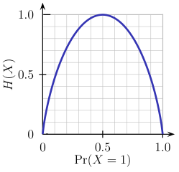
Decision Tree (CO1,2,3,5)
Entropy:
Entropy is a measure of the randomness in the information being processed.
The higher the entropy, the harder it is to draw any conclusions from that information.
Flipping a coin is an example of an action that provides information that is random.

Slide 75
Decision Tree (CO1,2,3,5)
From the above graph, it is quite evident that the entropy H(X) is zero when the probability is either 0 or 1.
The Entropy is maximum when the probability is 0.5 because it projects perfect randomness in the data and there is no chance if perfectly determining the outcome.
ID3 follows the rule — A branch with an entropy of zero is a leaf node and A branch with entropy more than zero needs further splitting.

Slide 76
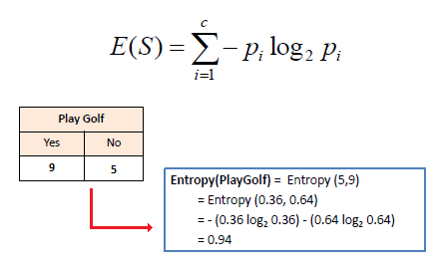
Decision Tree (CO1,2,3,5)
Mathematically Entropy for 1 attribute is represented as:
Where S → Current state, and Pi → Probability of an event i of state S or Percentage of class i in a node of state S.

Slide 77
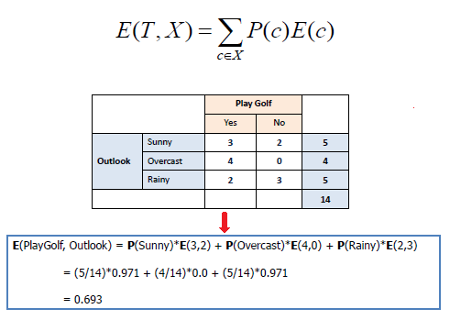
Decision Tree (CO1,2,3,5)
Mathematically Entropy for multiple attributes is represented as:
where T→ Current state and X → Selected attribute

Slide 78
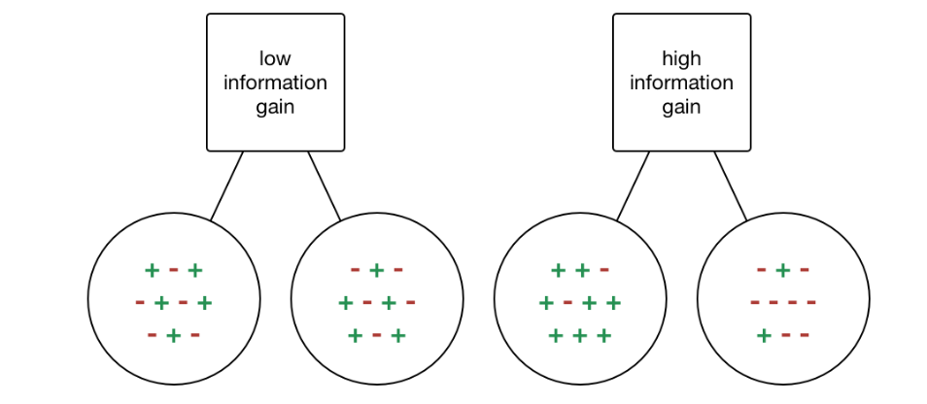
Decision Tree (CO1,2,3,5)
Information Gain:
Information gain or IG is a statistical property that measures how well a given attribute separates the training examples according to their target classification.
Constructing a decision tree is all about finding an attribute that returns the highest information gain and the smallest entropy.

Slide 79
Decision Tree (CO1,2,3,5)
Information gain is a decrease in entropy.
It computes the difference between entropy before split and average entropy after split of the dataset based on given attribute values.
ID3 (Iterative Dichotomiser) decision tree algorithm uses information gain.

Slide 80
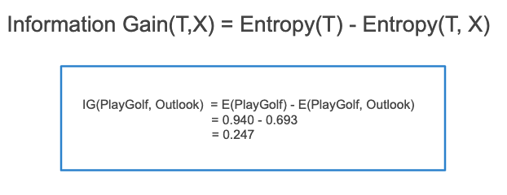
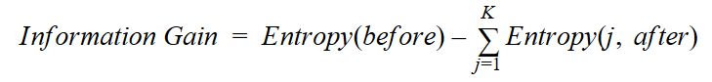
Decision Tree (CO1,2,3,5)
Mathematically, IG is represented as:
Where “before” is the dataset before the split, K is the number of subsets generated by the split, and (j, after) is subset j after the split.

Slide 81
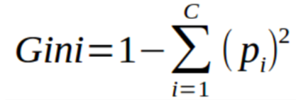
Decision Tree (CO1,2,3,5)
Gini Index
You can understand the Gini index as a cost function used to evaluate splits in the dataset.
It is calculated by subtracting the sum of the squared probabilities of each class from one.
It favors larger partitions and easy to implement whereas information gain favors smaller partitions with distinct values.
Gini Index works with the categorical target variable “Success” or “Failure”. It performs only Binary splits.
Higher the value of Gini index higher the homogeneity.

Slide 82
Decision Tree (CO1,2,3,5)
Steps to Calculate Gini index for a split
Calculate Gini for sub-nodes, using the above formula for success(p) and failure(q) (p²+q²).
Calculate the Gini index for split using the weighted Gini score of each node of that split.
CART (Classification and Regression Tree) uses the Gini index method to create split points.

Slide 83
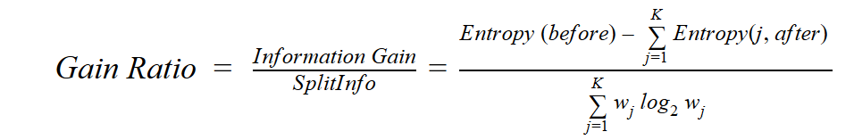
Decision Tree (CO1,2,3,5)
Gain ratio
Information gain is biased towards choosing attributes with a large number of values as root nodes.
It means it prefers the attribute with a large number of distinct values.
C4.5, an improvement of ID3, uses Gain ratio which is a modification of Information gain that reduces its bias and is usually the best option.
Gain ratio overcomes the problem with information gain by taking into account the number of branches that would result before making the split.
It corrects information gain by taking the intrinsic information of a split into account.
Where “before” is the dataset before the split, K is the number of subsets generated by the split, and (j, after) is subset j after the split.

Slide 84
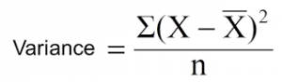
Decision Tree (CO1,2,3,5)
Reduction in Variance:
Reduction in variance is an algorithm used for continuous target variables (regression problems).
This algorithm uses the standard formula of variance to choose the best split.
The split with lower variance is selected as the criteria to split the population:
Above X-bar is the mean of the values, X is actual and n is the number of values.
Steps to calculate Variance:
Calculate variance for each node.
Calculate variance for each split as the weighted average of each node variance.

Slide 85
Decision Tree (CO1,2,3,5)
Chi-Square:
The acronym CHAID stands for Chi-squared Automatic Interaction Detector.
It is one of the oldest tree classification methods.
It finds out the statistical significance between the differences between sub-nodes and parent node.
We measure it by the sum of squares of standardized differences between observed and expected frequencies of the target variable.
It works with the categorical target variable “Success” or “Failure”.
It can perform two or more splits.
Higher the value of Chi-Square higher the statistical significance of differences between sub-node and Parent node.
It generates a tree called CHAID (Chi-square Automatic Interaction Detector).

Slide 86
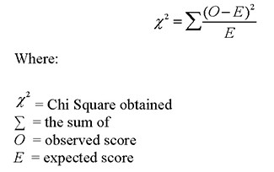
Decision Tree (CO1,2,3,5)
Mathematically, Chi-squared is represented as:
Steps to Calculate Chi-square for a split:
Calculate Chi-square for an individual node by calculating the deviation for Success and Failure both
Calculated Chi-square of Split using Sum of all Chi-square of success and Failure of each node of the split

Slide 87
Decision Tree (CO1,2,3,5)
Issues in Decision Tree:
The common problem with Decision trees, especially having a table full of columns, they fit a lot.
Sometimes it looks like the tree memorized the training data set.
If there is no limit set on a decision tree, it will give you 100% accuracy on the training data set because in the worse case it will end up making 1 leaf for each observation.
Thus this affects the accuracy when predicting samples that are not part of the training set.
Here are two ways to remove overfitting:
Pruning Decision Trees.
Random Forest

Slide 88
Decision Tree (CO1,2,3,5)
Pruning Decision Trees:
In pruning, you trim off the branches of the tree, i.e., remove the decision nodes starting from the leaf node such that the overall accuracy is not disturbed.
This is done by segregating the actual training set into two sets: training data set, D and validation data set, V.
Prepare the decision tree using the segregated training data set, D.
Then continue trimming the tree accordingly to optimize the accuracy of the validation data set, V.

Slide 89
Decision Tree (CO1,2,3,5)

Slide 90
Decision Tree (CO1,2,3,5)

Slide 91
Decision Tree (CO1,2,3,5)

Slide 92
Decision Tree (CO1,2,3,5)

Slide 93
Decision Tree (CO1,2,3,5)

Slide 94
Decision Tree (CO1,2,3,5)

Slide 95
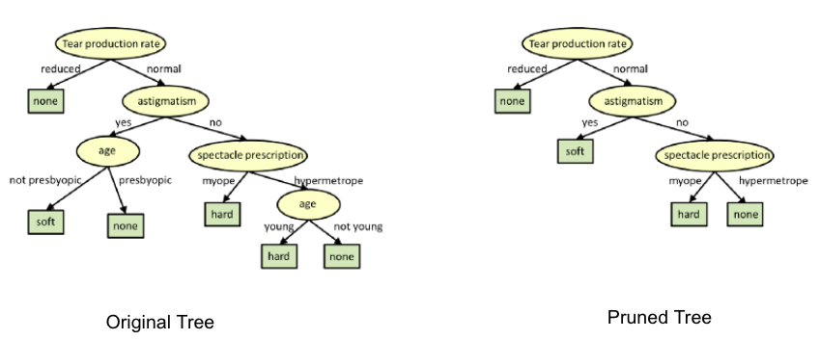
Decision Tree (CO1,2,3,5)
In the above diagram, the ‘Age’ attribute in the left-hand side of the tree has been pruned as it has more importance on the right-hand side of the tree, hence removing overfitting.

Slide 96
Decision Tree (CO1,2,3,5)
Random Forest
Random Forest is an example of ensemble learning, in which we combine multiple machine learning algorithms to obtain better predictive performance.
Why the name “Random”?
Two key concepts that give it the name random:
A random sampling of training data set when building trees.
Random subsets of features considered when splitting nodes.
A technique known as bagging is used to create an ensemble of trees where multiple training sets are generated with replacement.

Slide 97
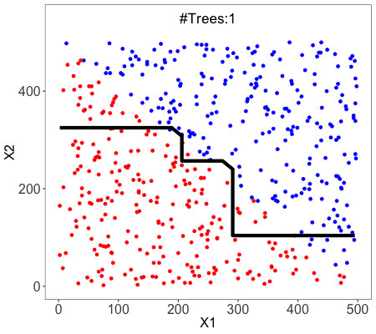
Decision Tree (CO1,2,3,5)
In the bagging technique, a data set is divided into N samples using randomized sampling.
Then, using a single learning algorithm a model is built on all samples.
Later, the resultant predictions are combined using voting or averaging in parallel.

Slide 98
Introduction of Machine Learning Approaches(CO1,2,3,4)
A Neural Network
A neural network is a processing device, either an algorithm or an actual hardware, whose design was inspired by the design and functioning of animal brains and components thereof.
The neural networks have ability to learn by example, which makes them very flexible and powerful.
These networks are also well suited for real-time systems because of their fast response and computational times which are because of their parallel architecture.

Slide 99
Introduction of Machine Learning Approaches(CO1,2,3,4)
Artificial Neural Network: Definition:
An artificial neural network (ANN) may be defined as an information processing model that is inspired by the way biological nervous systems, such as the brain, process information.
This model tries to replicate only the most basic functions of the brain.
The key element of ANN is the novel structure of its information processing system.
An ANN is composed of a large number of highly interconnected processing elements (neurons) working in unison to solve specific problems.
Artificial neural networks, like people, learn by example.

Slide 100
Introduction of Machine Learning Approaches(CO1,2,3,4)
Advantages of Neural Networks:
Adaptive learning: An ANN is endowed with the ability to learn how to do tasks based on the data given for training or initial experience.
Self-organization: An ANN can create its own organization or representation of the information it receives during learning time.
Real-time operation: ANN computations may be carried out in parallel. Special hardware devices are being designed and manufactured to rake advantage of this capability of ANNs.
Fault tolerance via redundant information coding: Partial destruction of a neural network leads to the corresponding degradation of performance. However, some network capabilities may be retrained even after major network damage.

Slide 101
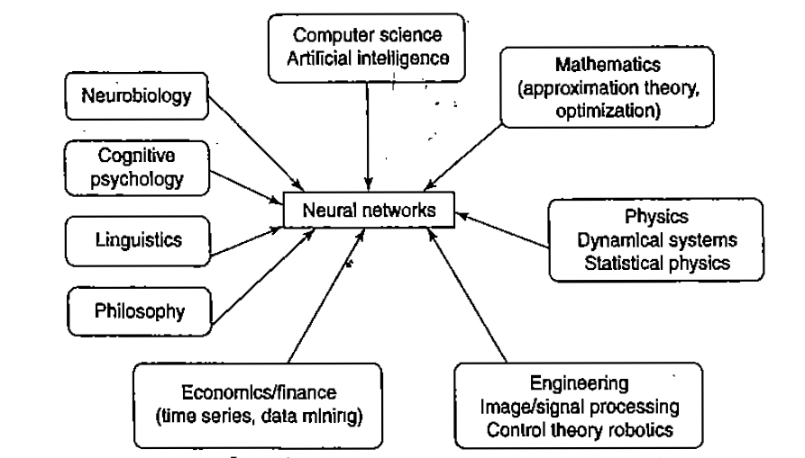
Introduction of Machine Learning Approaches(CO1,2,3,4)

Slide 102
Introduction of Machine Learning Approaches(CO1,2,3,4)
Application Scope of Neural Networks:
Air traffic control.
Animal behavior, predator/prey relationships and population cycles.
Appraisal and valuation of property, buildings, automobiles, machinery, etc.
Betting on horse races, stock markets, sporting events, etc.
Criminal sentencing could be predicted using a large sample of crime details as input and the resulting sentence as output.
Complex physical and chemical processes that may involve the interaction of numerous (possibly unknown) mathematical formulas could be modeled heuristically using a neural network.
Echo patterns from sonar, radar, seismic and magnetic instruments could be used to predict their targets.

Slide 103
Neural Networks (CO1, CO2, CO3)
An artificial neural network (ANN) is an efficient information processing system which resembles in characteristics with a biological neural network.
ANNs possess large number of highly interconnected processing elements called nodes or units or neuron, which usually operate in parallel and are configured in regular architectures.
Each neuron is connected with the other by a connection link.
Each connection link is associated with weights which contain information about input signals.
This information is used by the neuron to solve a particular problem.

Slide 104
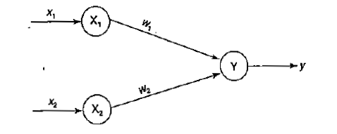
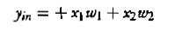
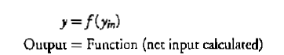
Neural Networks (CO1, CO2, CO3)
To depict the basic operation of a neural net, consider a set of neurons, say X1 and X2, transmitting signals to another neuron, Y.
Here X1 and X2 are input neurons, which transmit signals, and Y is the output neuron, which receives signals.
Input neurons X1 and X2 are connected to the output neuron Y, over a weighted interconnection links (W1 and W2).
Activation Function

Slide 105

Biological Neural Networks (CO1, CO2, CO3)
The Architecture of Neuron

Slide 106

Biological Neural Networks(CO1, CO2, CO3)

Slide 107


Model of ANN (CO1, CO2, CO3)

Slide 108
Model of ANN (CO1, CO2, CO3)

Slide 109
Model of ANN (CO1, CO2, CO3)

Slide 110
Neural Networks (CO1, CO2, CO3)
Characteristics of ANN:
It is a neutrally implemented mathematical model.
There exists a large number of highly interconnected processing elements called neurons in an ANN.
The interconnections with their weighted linkages hold the informative knowledge.
The input signals arrive at the processing elements through connections and connecting weights.
The processing elements of the ANN have the ability to learn, recall and generalize from the given data by suitable assignment or adjustment of weights.
The computational power can be demonstrated only by the collective behavior of neurons, and it should be noted that no single neuron carries specific information.

Slide 111
Models of Neural Networks (CO1, CO2, CO3)
The models of ANN are specified by the three basic entities namely:
The model’s synaptic interconnections.
The training or learning rules adopted for updating and adjusting the connection weights.
Their activation functions.

Slide 112
Models of Neural Networks(CO1, CO2, CO3)
Network Architecture of ANN:
1. single-layer feed-forward network;
2. multilayer feed-forward network;
3. single node with its own feedback;
4. single-layer recurrent network;
5. multilayer recurrent network.

Slide 113

Models of Neural Networks(CO1, CO2, CO3)
Single Layer Feed Forward Network:

Slide 114

Models of Neural Networks (CO1, CO2, CO3)
a

Slide 115

Models of Neural Networks (CO1, CO2, CO3)

Slide 116

Models of Neural Networks (CO1, CO2, CO3)

Slide 117

Models of Neural Networks (CO1, CO2, CO3)

Slide 118

Models of Neural Networks (CO1, CO2, CO3)
Lateral Inhibition Structure

Slide 119
Activation Function of ANN (CO1, CO2, CO3)
Types of Activation Function of ANN :
Identity Function
Binary Step Function
Bipolar Step Function
Sigmoidal Functions
Ramp Function

Slide 120


Activation Function of ANN (CO1, CO2, CO3)
Identity function: It is a linear function and can be defined as
The output here remains the same as input. The input layer uses the identity activation function.

Slide 121


Activation Function of ANN(CO1, CO2, CO3)
Binary step function: This function can be defined as:
where Ɵ represents the threshold value. This function is most widely used in single-layer nets to convert the net input to an output that is a binary (1 or 0).

Slide 122


Activation Function of ANN(CO1, CO2, CO3)
Bipolar step function: This function can be defined as
where Ɵ represents the threshold value. This function is also used in single-layer nets to convert the input to an output that is bipolar(+ 1 or -1).

Slide 123


Activation Function of ANN(CO1, CO2, CO3)
Sigmoidal functions-. The sigmoidal functions are widely used in back-propagation nets because of the relationship between the value of the functions at a point and the values of the derivative at that point which reduce the computational burden during training.
Binary sigmoid function: It is also referred as logistic sigmoid function or unipolar sigmoid function. It can be defined as:
where A is the steepness parameter. The derivative of this function is
Here the range of the sigmoid function is from 0 to 1.

Slide 124

Activation Function of ANN(CO1, CO2, CO3)
a

Slide 125

Activation Function of ANN(CO1, CO2, CO3)
a

Slide 126



Activation Function of ANN(CO1, CO2, CO3)
Binary sigmoidal function:
Bipolar sigmoidal function:
Ramp Function

Slide 127

Terminologies of ANN (CO1, CO2, CO3)
Weights:
In the architecture of an ANN, each neuron is connected to other neurons by means of directed communication links, and each communication link is associated with weights.
The weight contain information about the input signal.
This information is used by the net to solve a problem.
The weight can be represented by the form of Matrix

Slide 128



Neural Networks (CO1, CO2, CO3)
Bias:
The bias included in the network has impact in calculating the net input.
The bias is included by adding a component x0 = 1 to the input vector X.

Slide 129

Neural Networks (CO1, CO2, CO3)
Threshold
Threshold is a set value based upon which the final output of the network may be calculated.
The threshold value is used in the activation function.
A comparison is made between the calculated net input and the threshold to obtain the network output.
For each and every application there is a threshold limit.

Slide 130
Neural Networks (CO1, CO2, CO3)
Learning Rate:
The learning rate is denoted by "α." It is used to control the amount of weight adjustment at each step of training. The learning rate , ranging from 0 to 1, determine the rate of learning at each time step.

Slide 131
Model of ANN (CO1, CO2, CO3)

Slide 132
Model of ANN (CO1, CO2, CO3)

Slide 134



Neural Networks Questions (CO1, CO2, CO3)
NOTE: All has to solve the questions send to you and revert back in group.

Slide 135


Neural Networks (CO1, CO2, CO3)
a

Slide 136

Neural Networks (CO1, CO2, CO3)
a

Slide 137


Neural Networks (CO1, CO2, CO3)

Slide 138


Neural Networks (CO1, CO2, CO3)

Slide 139

Neural Networks (CO1, CO2, CO3)

Slide 140
McCulloch-Pitts Neuron(CO1, CO2, CO3)
McCulloch-Pitts Neuron:
The McCulloch-Pitts neuron was the earliest neural network discovered in 1943.
It is usually called as M-P neuron.
The M-P neurons are connected by directed weighted paths.
It should be noted that the activation of a M-P neuron is binary, that is, at any time step the neuron may fire or may not fire.
The weights associated with the communication links may be excitatory (weight is positive) or inhibitory (weight is negative).
All the excitatory connected weights entering into a particular neuron will have same weights.
The threshold plays a major role in M-P neuron:

Slide 141

McCulloch-Pitts Neuron(CO1, CO2, CO3)

Slide 142
McCulloch-Pitts Neuron(CO1, CO2, CO3)
A simple M-P neuron is shown in Figure in previous slide.
The M-P neuron has both excitatory and inhibitory connections.
It is excitatory with weight (w > 0) or inhibitory with weight -p(p < 0).
Input from Xi ro Xn possess excitatory weighted connections and inputs from Xn+ 1 to Xn+m possess inhibitory weighted interconnections.
The activation function here is defined as:
For inhibition to be absolute, the threshold with the activation function should satisfy the following condition:
For excitatory connections the threshold will be :

Slide 143
McCulloch-Pitts Neuron(CO1, CO2, CO3)
The M-P neuron has no particular training algorithm.
An analysis has to be performed to determine the values of the weights and the threshold.
Here the weights of the neuron are set along with the threshold to make the neuron "perform a simple logic function.

Slide 144
Hebb Network(CO1, CO2, CO3)
For a neural net, the Hebb learning rule is a simple one.
Donald Hebb stated in 1949 that in the brain, the learning is performed by the change in the synaptic gap.
When an axon of a cell A is near enough to excite cell B, and repeatedly or permanently takes place in firing it, some growth process or metabolic change takes place in one or both the cells such that A’s efficiency as one of the cells training B, is increased.
According to the Hebb rule, the weight vector is found to increase proportionately to the product of the input and the learning signal.
Here the learning signal is equal to the neuron's output.

Slide 145
Hebb Network (CO1,2,3,5)
The weight update in Hebb rule is given by:
The Hebb rule is more suited for bipolar data than binary data. If binary data is used, then above weight updating formula cannot distinguish two conditions namely;
1. A training pair in which an input unit is "on" and target value is "off."
2. A training pair in which both the input unit and the target value are "off."

Slide 146
Hebb Network (CO1,2,3,5)

Slide 147
Hebb Network (CO1,2,3,5)
Design a Hebb net to implement logical AND function (use bipolar inputs and targets).
Solution: The training data for the AND function is
given in Table:
The network is trained using the Hebb network training
algorithm. lnitially the weights and bias are set to zero, i.e.,
W1=w2=b=0

Slide 148
Hebb Network (CO1,2,3,5)

Slide 149
Hebb Network (CO1,2,3,5)

Slide 150
Hebb Network (CO1,2,3,5)

Slide 151
Hebb Network (CO1,2,3,5)

Slide 152
Hebb Network (CO1,2,3,5)

Slide 153
Hebb Network (CO1,2,3,5)

Slide 154
Perceptron Networks (CO1,2,3,5)
Perceptron network consists of three units, namely, sensory unit (input unit), associator unit (hidden unit), response unit (output unit).
The sensory units are connected to associator units with fixed weights having values 1, 0 or -l, which are assigned at random.
The binary activation function is used in sensory unit and associator unit.
The response unit has an activation of l, 0 or -1.
The binary step will fixed threshold Ɵ is used as activation for associator.
The output signals that are sent from the associator unit to the response unit are only binary.
The output of the perceptron network is given by:
where is activation function and is defined as:

Slide 155
Perceptron Networks (CO1,2,3,5)
The perceptron learning rule is used in the weight updating between the associator unit and the response unit.
For each training input, the net will calculate the response and it will determine whether or not an error has occurred.
The error calculation is based on the comparison of the targets with those of the calculated outputs.
The weights on the connections from the units that send the nonzero signal will get adjusted suitably.
The weights will be adjusted on the basis of the learning rule if an error has occurred for a particular training patterns i.e..,
If no error occurs, there is no weight updating and hence the training process may be stopped.
In the above equations, the target value "t" is+ I or –l and a is the learning rate.

Slide 156
Perceptron Networks (CO1,2,3,5)

Slide 157
Perceptron Networks (CO1,2,3,5)
Perceptron Learning Rule:
The perceptron learning rule is explained as follows:
Consider a finite "n" number of input training vectors, with their associated target (desired) values x(n)
and t{n), where "n" ranges from 1 to N. The target is either + 1 or -1. The output ''y" is obtained on the basis of the net input calculated and activation function being applied over the net input.

Slide 158
Perceptron Networks (CO1,2,3,5)
The weight updation in case of perceptron learning is as shown.

Slide 159
Perceptron Networks (CO1,2,3,5)

Slide 160
Perceptron Networks (CO1,2,3,5)

Slide 161
Perceptron Networks (CO1,2,3,5)

Slide 162
Perceptron Networks (CO1,2,3,5)

Slide 163
Perceptron Networks (CO1,2,3,5)

Slide 164
Perceptron Networks (CO1,2,3,5)

Slide 165
Perceptron Networks (CO1,2,3,5)

Slide 166
Perceptron Networks (CO1,2,3,5)

Slide 167
Perceptron Networks (CO1,2,3,5)

Slide 168
ASSIGNMENTS (CO1,2,3,5)
Q1: Design Hebb Network for both AND and OR function.
Q2: Design Perceptron Network for both AND and OR Function.
NOTE: Complete the assignment and send it to Group.

Slide 169
SVM (CO1,2,3,4,5)
The Support Vector Machine is a supervised learning algorithm mostly used for classification but it can be used also for regression.
The main idea is that based on the labeled data (training data) the algorithm tries to find the optimal hyperplane which can be used to classify new data points.
In two dimensions the hyperplane is a simple line.
Usually a learning algorithm tries to learn the most common characteristics (what differentiates one class from another) of a class and the classification is based on those representative characteristics learnt (so classification is based on differences between classes).
The SVM works in the other way around. It finds the most similar examples between classes. Those will be the support vectors.

Slide 170
SVM (CO1,2,3,4,5)
As an example, lets consider two classes, apples and lemons.
Other algorithms will learn the most evident, most representative characteristics of apples and lemons, like apples are green and rounded while lemons are yellow and have elliptic form.
In contrast, SVM will search for apples that are very similar to lemons, for example apples which are yellow and have elliptic form.
This will be a support vector. The other support vector will be a lemon similar to an apple (green and rounded).
So other algorithms learns the differences while SVM learns similarities.

Slide 171

SVM (CO1,2,3,4,5)

Slide 172
SVM (CO1,2,3,4,5)
As we go from left to right, all the examples will be classified as apples until we reach the yellow apple.
From this point, the confidence that a new example is an apple drops while the lemon class confidence increases.
When the lemon class confidence becomes greater than the apple class confidence, the new examples will be classified as lemons (somewhere between the yellow apple and the green lemon).
Based on these support vectors, the algorithm tries to find the best hyperplane that separates the classes.
In 2D the hyperplane is a line, so it would look like this:

Slide 173

SVM (CO1,2,3,4,5)

Slide 174

SVM (CO1,2,3,4,5)
Finding the Optimal Hyperplane
Intuitively the best line is the line that is far away from both apple and lemon examples (has the largest margin). To have optimal solution, we have to maximize the margin in both ways (if we have multiple classes, then we have to maximize it considering each of the classes).

Slide 175

SVM (CO1,2,3,4,5)
So if we compare the picture above with the picture below, we can easily observe, that the first is the optimal hyperplane (line) and the second is a sub-optimal solution, because the margin is far shorter.

Slide 176

SVM (CO1,2,3,4,5)
Because we want to maximize the margins taking in consideration all the classes, instead of using one margin for each class, we use a “global” margin, which takes in consideration all the classes. This margin would look like the purple line in the following picture:

Slide 177
SVM (CO1,2,3,4,5)
This margin is orthogonal to the boundary and equidistant to the support vectors.
So where do we have vectors? Each of the calculations (calculate distance and optimal hyperplanes) are made in vectorial space, so each data point is considered a vector. The dimension of the space is defined by the number of attributes of the examples. To understand the math behind, please read this brief mathematical description of vectors, hyperplanes and optimizations: SVM Succintly.
All in all, support vectors are data points that defines the position and the margin of the hyperplane. We call them “support” vectors, because these are the representative data points of the classes, if we move one of them, the position and/or the margin will change. Moving other data points won’t have effect over the margin or the position of the hyperplane.
To make classifications, we don’t need all the training data points (like in the case of KNN), we have to save only the support vectors. In worst case all the points will be support vectors, but this is very rare and if it happens, then you should check your model for errors or bugs.
So basically the learning is equivalent with finding the hyperplane with the best margin, so it is a simple optimization problem.

Slide 178
SVM (CO1,2,3,4,5)
Basic Steps
The basic steps of the SVM are:
select two hyperplanes (in 2D) which separates the data with no points between them (red lines)
maximize their distance (the margin)
the average line (here the line half way between the two red lines) will be the decision boundary
This is very nice and easy, but finding the best margin, the optimization problem is not trivial (it is easy in 2D, when we have only two attributes, but what if we have N dimensions with N a very big number)
To solve the optimization problem, we use the Lagrange Multipliers. To understand this technique you can read the following two articles: Duality Langrange Multiplier and A Simple Explanation of Why Langrange Multipliers Wroks.
Until now we had linearly separable data, so we could use a line as class boundary. But what if we have to deal with non-linear data sets?

Slide 179

SVM (CO1,2,3,4,5)
SVM for Non-Linear Data Sets
An example of non-linear data is:

Slide 180
SVM (CO1,2,3,4,5)
In this case we cannot find a straight line to separate apples from lemons. So how can we solve this problem. We will use the Kernel Trick!
The basic idea is that when a data set is inseparable in the current dimensions, add another dimension, maybe that way the data will be separable.
Just think about it, the example above is in 2D and it is inseparable, but maybe in 3D there is a gap between the apples and the lemons, maybe there is a level difference, so lemons are on level one and lemons are on level two.
In this case we can easily draw a separating hyperplane (in 3D a hyperplane is a plane) between level 1 and 2.

Slide 181

SVM (CO1,2,3,4,5)
Mapping to Higher Dimensions
To solve this problem we shouldn’t just blindly add another dimension, we should transform the space so we generate this level difference intentionally.
Mapping from 2D to 3D
Let's assume that we add another dimension called X3. Another important transformation is that in the new dimension the points are organized using this formula x1² + x2².
If we plot the plane defined by the x² + y² formula, we will get something like this:

Slide 182
SVM (CO1,2,3,4,5)
Now we have to map the apples and lemons (which are just simple points) to this new space.
Think about it carefully, what did we do?
We just used a transformation in which we added levels based on distance.
If you are in the origin, then the points will be on the lowest level.
As we move away from the origin, it means that we are climbing the hill (moving from the center of the plane towards the margins) so the level of the points will be higher.
Now if we consider that the origin is the lemon from the center, we will have something like this:

Slide 183

SVM (CO1,2,3,4,5)

Slide 184
SVM (CO1,2,3,4,5)
Now we can easily separate the two classes.
These transformations are called kernels.
Popular kernels are:
Polynomial Kernel,
Gaussian Kernel,
Radial Basis Function (RBF),
Laplace RBF Kernel,
Sigmoid Kernel,
Anove RBF Kernel, etc

Slide 185
SVM (CO1,2,3,4,5)
SVM Kernel Functions
SVM algorithms use a set of mathematical functions that are defined as the kernel. The function of kernel is to take data as input and transform it into the required form. Different SVM algorithms use different types of kernel functions. These functions can be different types. For example linear, nonlinear, polynomial, radial basis function (RBF), and sigmoid. Introduce Kernel functions for sequence data, graphs, text, images, as well as vectors. The most used type of kernel function is RBF. Because it has localized and finite response along the entire x-axis. The kernel functions return the inner product between two points in a suitable feature space. Thus by defining a notion of similarity, with little computational cost even in very high-dimensional spaces.

Slide 186


SVM (CO1,2,3,4,5)
Kernel Rules
Define kernel or a window function as follows:

Slide 187

SVM (CO1,2,3,4,5)
Examples of SVM Kernels
Let us see some common kernels used with SVMs and their uses:
1. Polynomial kernel
It is popular in image processing. Equation is:
2. Gaussian kernel
It is a general-purpose kernel; used when there is no prior knowledge about the data. Equation is:

Slide 188

SVM (CO1,2,3,4,5)
3. Gaussian radial basis function (RBF)
It is a general-purpose kernel; used when there is no prior knowledge about the data. Equation is:
4. Laplace RBF kernel
It is general-purpose kernel; used when there is no prior knowledge about the data. Equation is:
5. Hyperbolic tangent kernel
We can use it in neural networks. Equation is:

Slide 189


SVM (CO1,2,3,4,5)
6. Sigmoid kernel
We can use it as the proxy for neural networks. Equation is
7. Bessel function of the first kind Kernel
8. ANOVA radial basis kernel
9. Linear splines kernel in one-dimension

Slide 190

SVM (CO1,2,3,4,5)
Mapping from 1D to 2D
Another, easier example in 2D would be:

Slide 191

SVM (CO1,2,3,4,5)
After using the kernel and after all the transformations we will get:

Slide 192
SVM (CO1,2,3,4,5)
So after the transformation, we can easily delimit the two classes using just a single line.
In real life applications we won’t have a simple straight line, but we will have lots of curves and high dimensions. In some cases we won’t have two hyperplanes which separates the data with no points between them, so we need some trade-offs, tolerance for outliers. Fortunately the SVM algorithm has a so-called regularization parameter to configure the trade-off and to tolerate outliers.

Slide 193
SVM (CO1,2,3,4,5)
Tuning Parameters
As we saw in the previous section choosing the right kernel is crucial, because if the transformation is incorrect, then the model can have very poor results. As a rule of thumb, always check if you have linear data and in that case always use linear SVM (linear kernel). Linear SVM is a parametric model, but an RBF kernel SVM isn’t, so the complexity of the latter grows with the size of the training set. Not only is more expensive to train an RBF kernel SVM, but you also have to keep the kernel matrix around, and the projection into this “infinite” higher dimensional space where the data becomes linearly separable is more expensive as well during prediction. Furthermore, you have more hyperparameters to tune, so model selection is more expensive as well! And finally, it’s much easier to overfit a complex model!

Slide 194

SVM (CO1,2,3,4,5)
Regularization
The Regularization Parameter (in python it’s called C) tells the SVM optimization how much you want to avoid miss classifying each training example.
If the C is higher, the optimization will choose smaller margin hyperplane, so training data miss classification rate will be lower.
On the other hand, if the C is low, then the margin will be big, even if there will be miss classified training data examples. This is shown in the following two diagrams:

Slide 195

SVM (CO1,2,3,4,5)
Gamma
The next important parameter is Gamma. The gamma parameter defines how far the influence of a single training example reaches. This means that high Gamma will consider only points close to the plausible hyperplane and low Gamma will consider points at greater distance.

Slide 196
SVM (CO1,2,3,4,5)
As you can see, decreasing the Gamma will result that finding the correct hyperplane will consider points at greater distances so more and more points will be used (green lines indicates which points were considered when finding the optimal hyperplane).
Margin
The last parameter is the margin. We’ve already talked about margin, higher margin results better model, so better classification (or prediction). The margin should be always maximized.

Slide 197
SVM (CO1,2,3,4,5)
The most important parameters are:
kernel: the kernel type to be used. The most common kernels are rbf (this is the default value), poly or sigmoid, but you can also create your own kernel.
C: this is the regularization parameter described in the Tuning Parameters section
gamma: this was also described in the Tuning Parameters section
degree: it is used only if the chosen kernel is poly and sets the degree of the polinom
probability: this is a boolean parameter and if it’s true, then the model will return for each prediction, the vector of probabilities of belonging to each class of the response variable. So basically it will give you the confidences for each prediction.
shrinking: this shows whether or not you want a shrinking heuristic used in your optimization of the SVM, which is used in Sequential Minimal Optimization. It’s default value is true, an if you don’t have a good reason, please don’t change this value to false, because shrinking will greatly improve your performance, for very little loss in terms of accuracy in most cases.

Slide 198
SVM (CO1,2,3,4,5)
Advantages
SVN can be very efficient, because it uses only a subset of the training data, only the support vectors
Works very well on smaller data sets, on non-linear data sets and high dimensional spaces
Is very effective in cases where number of dimensions is greater than the number of samples
It can have high accuracy, sometimes can perform even better than neural networks
Not very sensitive to overfitting

Slide 199
Introduction (CO1)
Disadvantages
Training time is high when we have large data sets
When the data set has more noise (i.e. target classes are overlapping) SVM doesn’t perform well
Popular Use Cases
Text Classification
Detecting spam
Sentiment analysis
Aspect-based recognition
Aspect-based recognition
Handwritten digit recognition

Slide 200
SVM EXAMPLE (CO1)

Slide 201
Introduction (CO1)

Slide 202
Introduction (CO1)

Slide 203
Introduction (CO1)

Slide 204
Introduction (CO1)

Slide 205
Introduction (CO1)

Slide 206


Assignment 1:
1. Calculate the regression coefficient and obtain the lines of regression for the following data
2. Calculate the two regression equations of X on Y and Y on X from the data given below, taking deviations from a actual
means of X and Y.
Estimate the likely demand when the price is Rs.20.

Slide 207
Assignment 2:
What is entropy?
What is information gain?
How are entropy and information gain related vis-a-vis decision trees?
How do you calculate the entropy of children nodes after the split based on on a feature?
How do you decide a feature suitability when working with decision tree?
Explain feature selection using information gain/entropy technique?
Which algorithm (packaged) is used for building models based on the decision tree?
What are some of the techniques to decide decision tree pruning?

Slide 208
Daily Quiz
Decision Tree
Entropy, Information Gain, Gini Impurity
Decision Tree Working For Categorical and Numerical Features
What are the scenarios where Decision Tree works well
Decision Tree Low Bias And High Variance- Overfitting
Hyperparameter Techniques
Library used for constructing decision tree
Impact of Outliers Of Decision Tree
Impact of mising values on Decision Tree
Does Decision Tree require Feature Scaling

Slide 209
Glossary Questions
1. A _________ is a decision support tool that uses a tree-like graph or model of decisions and their possible consequences, including chance event outcomes, resource costs, and utility. a) Decision tree b) Graphs c) Trees d) Neural Networks
2. Decision Tree is a display of an algorithm. a) True b) False

Slide 210
Glossary Questions
3. What is Decision Tree? a) Flow-Chart b) Structure in which internal node represents test on an attribute, each branch represents outcome of test and each leaf node represents class label c) Flow-Chart & Structure in which internal node represents test on an attribute, each branch represents outcome of test and each leaf node represents class label d) None of the mentioned
4. Decision Trees can be used for Classification Tasks. a) True b) False

Slide 211
MCQ
Question 1 :
SVM stands for?
Options :
a. Simple Vector Machine
b. Support Vector Machine
c. Super Vector Machine
d. All the Above
Question 2 :
SVM is classified into how many types?
Options :
a. One
b. Two
c. Three
d. Four

Slide 212
MCQ
Question 3 :
SVM, which best segregates classes into how many classes?
Options :
a. One
b. Two
c. Three
d. Four
Question 4 :
SVM is a supervised Machine Learning can be used for
Options :
a. Regression
b. Classification
c. Either a or b
d. None of These

Slide 213
Faculty Video Links, Youtube & NPTEL Video Links and Online Courses Details
Youtube video-
https://www.youtube.com/watch?v=PDYfCkLY_DE
https://www.youtube.com/watch?v=ncOirIPHTOw
https://www.youtube.com/watch?v=cW03t3aZkmE

Slide 214
Weekly Assignment
Assignment 1
1. What are Support Vector Machines (SVMs)?
2. What are Support Vectors in SVMs?
3. What is the basic principle of a Support Vector Machine?
4. What are hard margin and soft Margin SVMs?
5. What do you mean by Hinge loss?
6. What is the “Kernel trick”?

Slide 215
Old Question Papers
Note: No old question paper available for this subject. Introduced first time.
I have added expected question for university exam in next slide.

Slide 216
Expected Questions for University Exam
What is the role of the C hyper-parameter in SVM? Does it affect the bias/variance trade-off?
Explain different types of kernel functions.
How you formulate SVM for a regression problem statement?
What affects the decision boundary in SVM?
What is a slack variable?
What is a dual and primal problem and how is it relevant to SVMs?

Slide 217
References
Text books:
1. Tom M. Mitchell, ―Machine Learning, McGraw-Hill Education (India) Private Limited, 2013.
2. Ethem Alpaydin, ―Introduction to Machine Learning (Adaptive Computation and Machine Learning), The MIT Press 2004.
3. Stephen Marsland, ―Machine Learning: An Algorithmic Perspective, CRC Press, 2009.
4. Bishop, C., Pattern Recognition and Machine Learning. Berlin: Springer-Verlag.

Slide 218
Recap of Unit
The performance and interpretation of linear regression analysis are subject to a variety of pitfalls, which are discussed here in detail. The reader is made aware of common errors of interpretation through practical examples. Both the opportunities for applying linear regression analysis and its limitations are presented.
A decision tree is a tree-shaped diagram that shows statistical probability or determines a course of action. It shows the analysts and by that, the decision-makers which steps they have to take and how different choices could affect the whole process.
SVM is a supervised learning algorithm which separates the data into different classes through the use of a hyperplane. The chosen hyperplane is one with the greatest margin between the hyperplane and all points, this yields the greatest likelihood of accurate classification.
Neural networks are suitable for predicting time series mainly because of learning only from examples, without any need to add additional information that can bring more confusion than prediction effect. Neural networks are able to generalize and are resistant to noise. On the other hand, it is generally not possible to determine exactly what a neural network learned and it is also hard to estimate possible prediction error.

